Slide 1
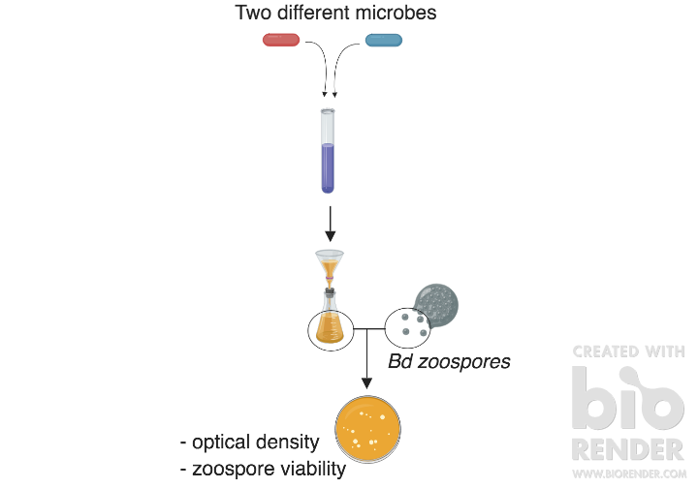
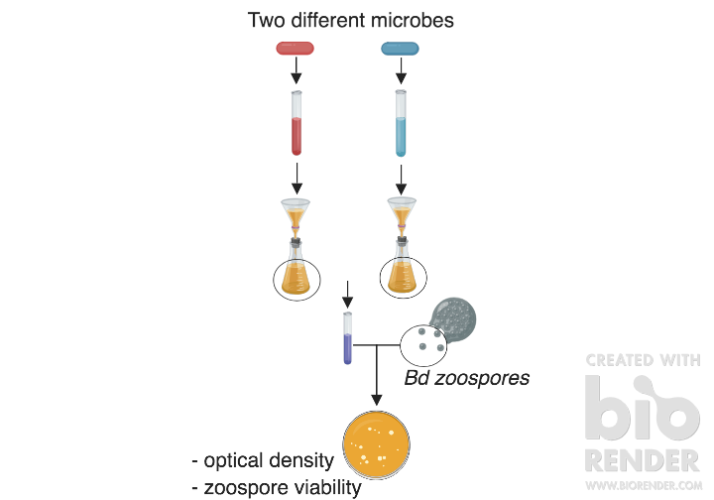
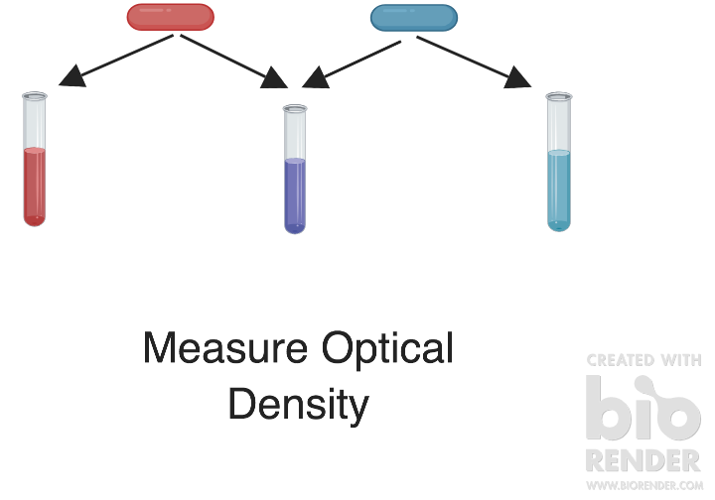
Facilitation: (b) and (c)
Metabolic: Additive/Synergistic/Antagonistic
Facilitation: (a)
CFS Effect on Bd Growth from Bacteria Grown Together
Separate-then-combined CSF Assay
Bacterial Isolates Grown Together and Separately
Grow for 5 days
Grow for 5 days
Grow for 5 days

Slide 2
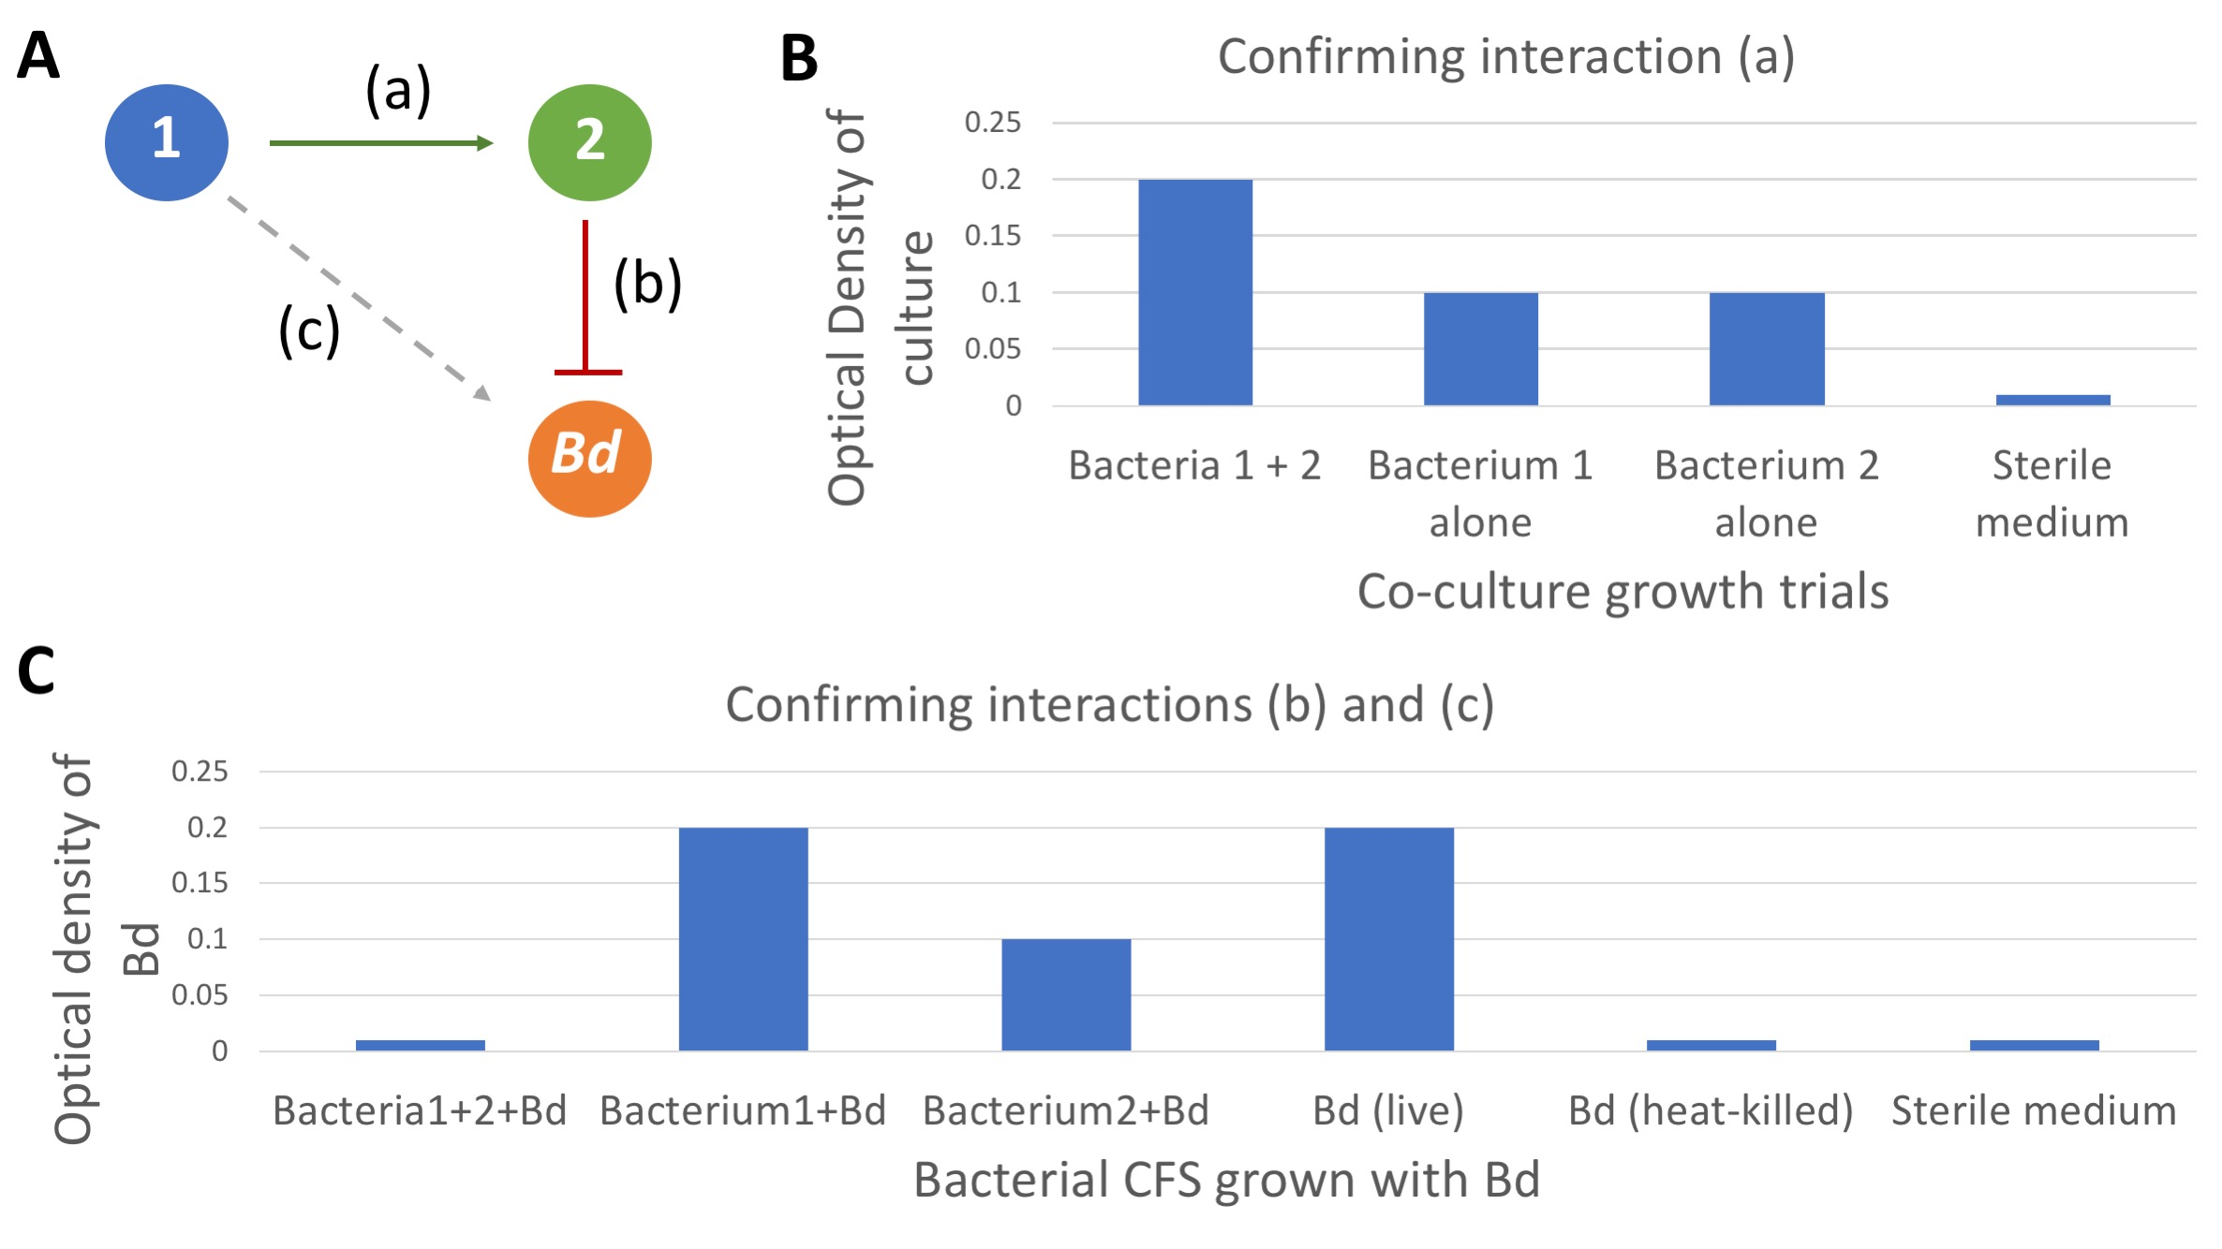
Facilitation: two isolates aid one another in Bd inhibition. Above is one possible example we tested for in our assays. Red shows inhibition and green shows positive interactions.

Slide 3
Bacterial candidates
Spot live bacteria onto Bd lawns
Measure zone of inhibition over 3 days

Slide 4
Bacteria versus Bd Lawn Assays
Spot live bacteria onto Bd lawns
Choosen Bacterial Isolates for Cocktails
Strong inhibitors: Psuedomonas, Microbacterium, Chryseobacterium
Violacein-producers: J. lividum (str-BTP), Collimonas
Low/no inhibition and at high abundance on tadpoles in past studies: Curvibacter
Facilitation: two isolates aid one another in Bd inhibition. Above is one possible example we tested for in our assays. Red shows inhibition and green shows positive interactions.
Measure zone of inhibition over 3 days

Slide 5
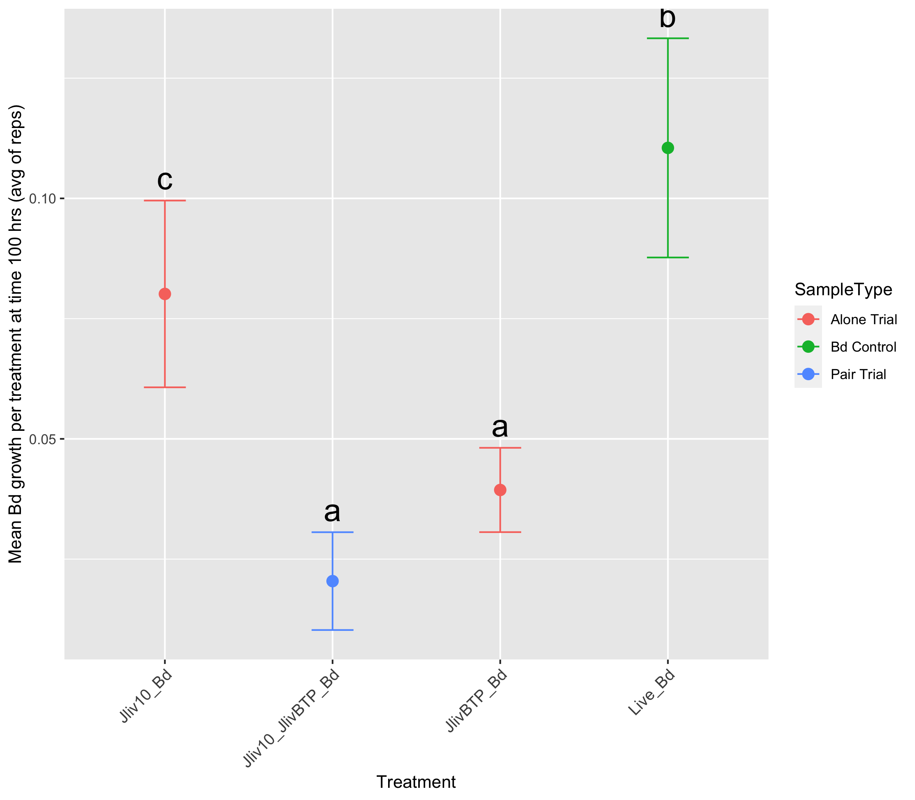
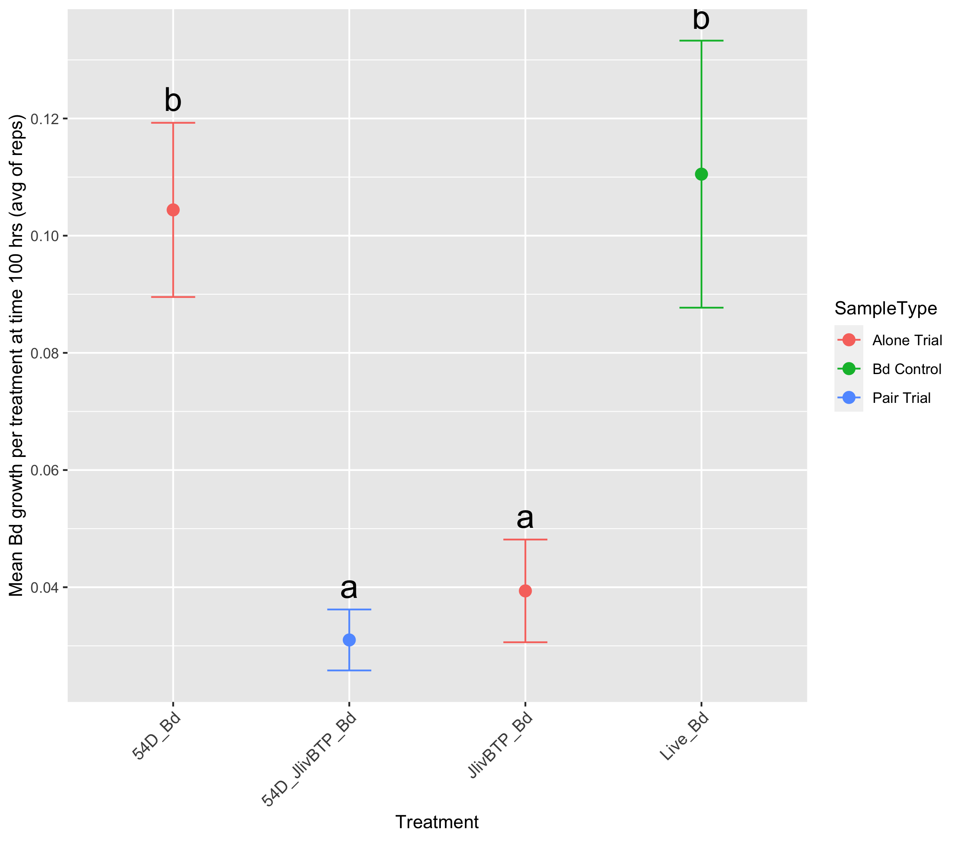
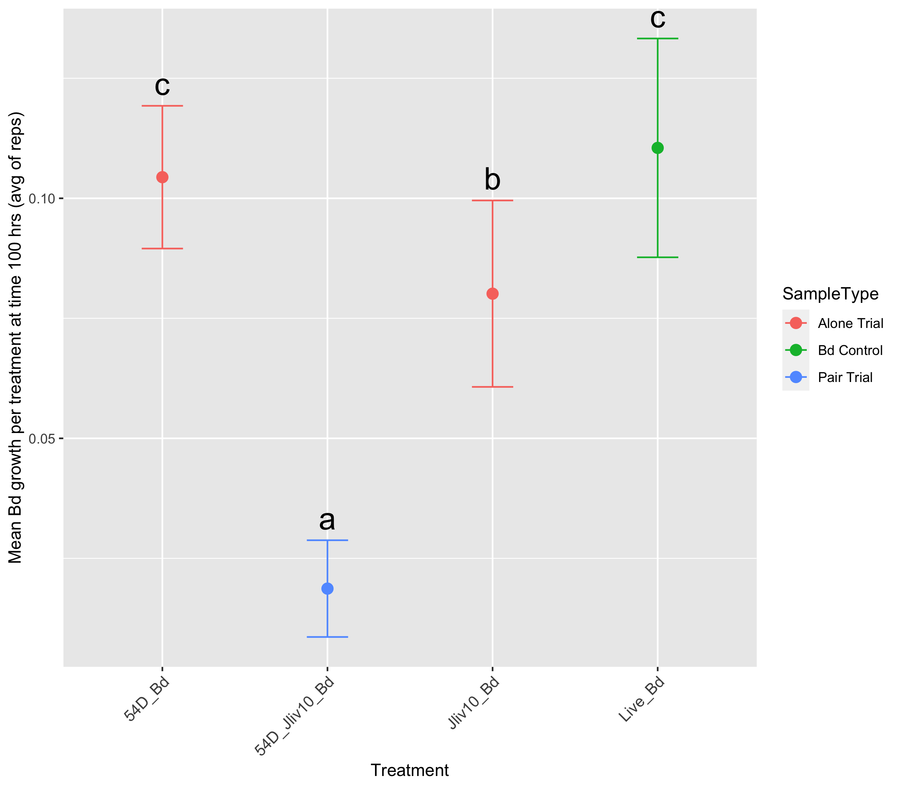
A
B
C
J. lividum (str-Jliv10)
J. lividum (str-Jliv10) and
J. lividum (str-BTP)
J. lividum (str-BTP)
Live Bd
Burkholdariales (sps. unk.)
Burkholdariales (sps. unk.) and J. lividum (str-BTP)
J. lividum (str-BTP)
Live Bd
Burkholdariales (sps. unk.)
Burkholdariales (sps. unk.) and J. lividum (str-Jliv10)
J. lividum (str-Jliv10)
Live Bd

Slide 6
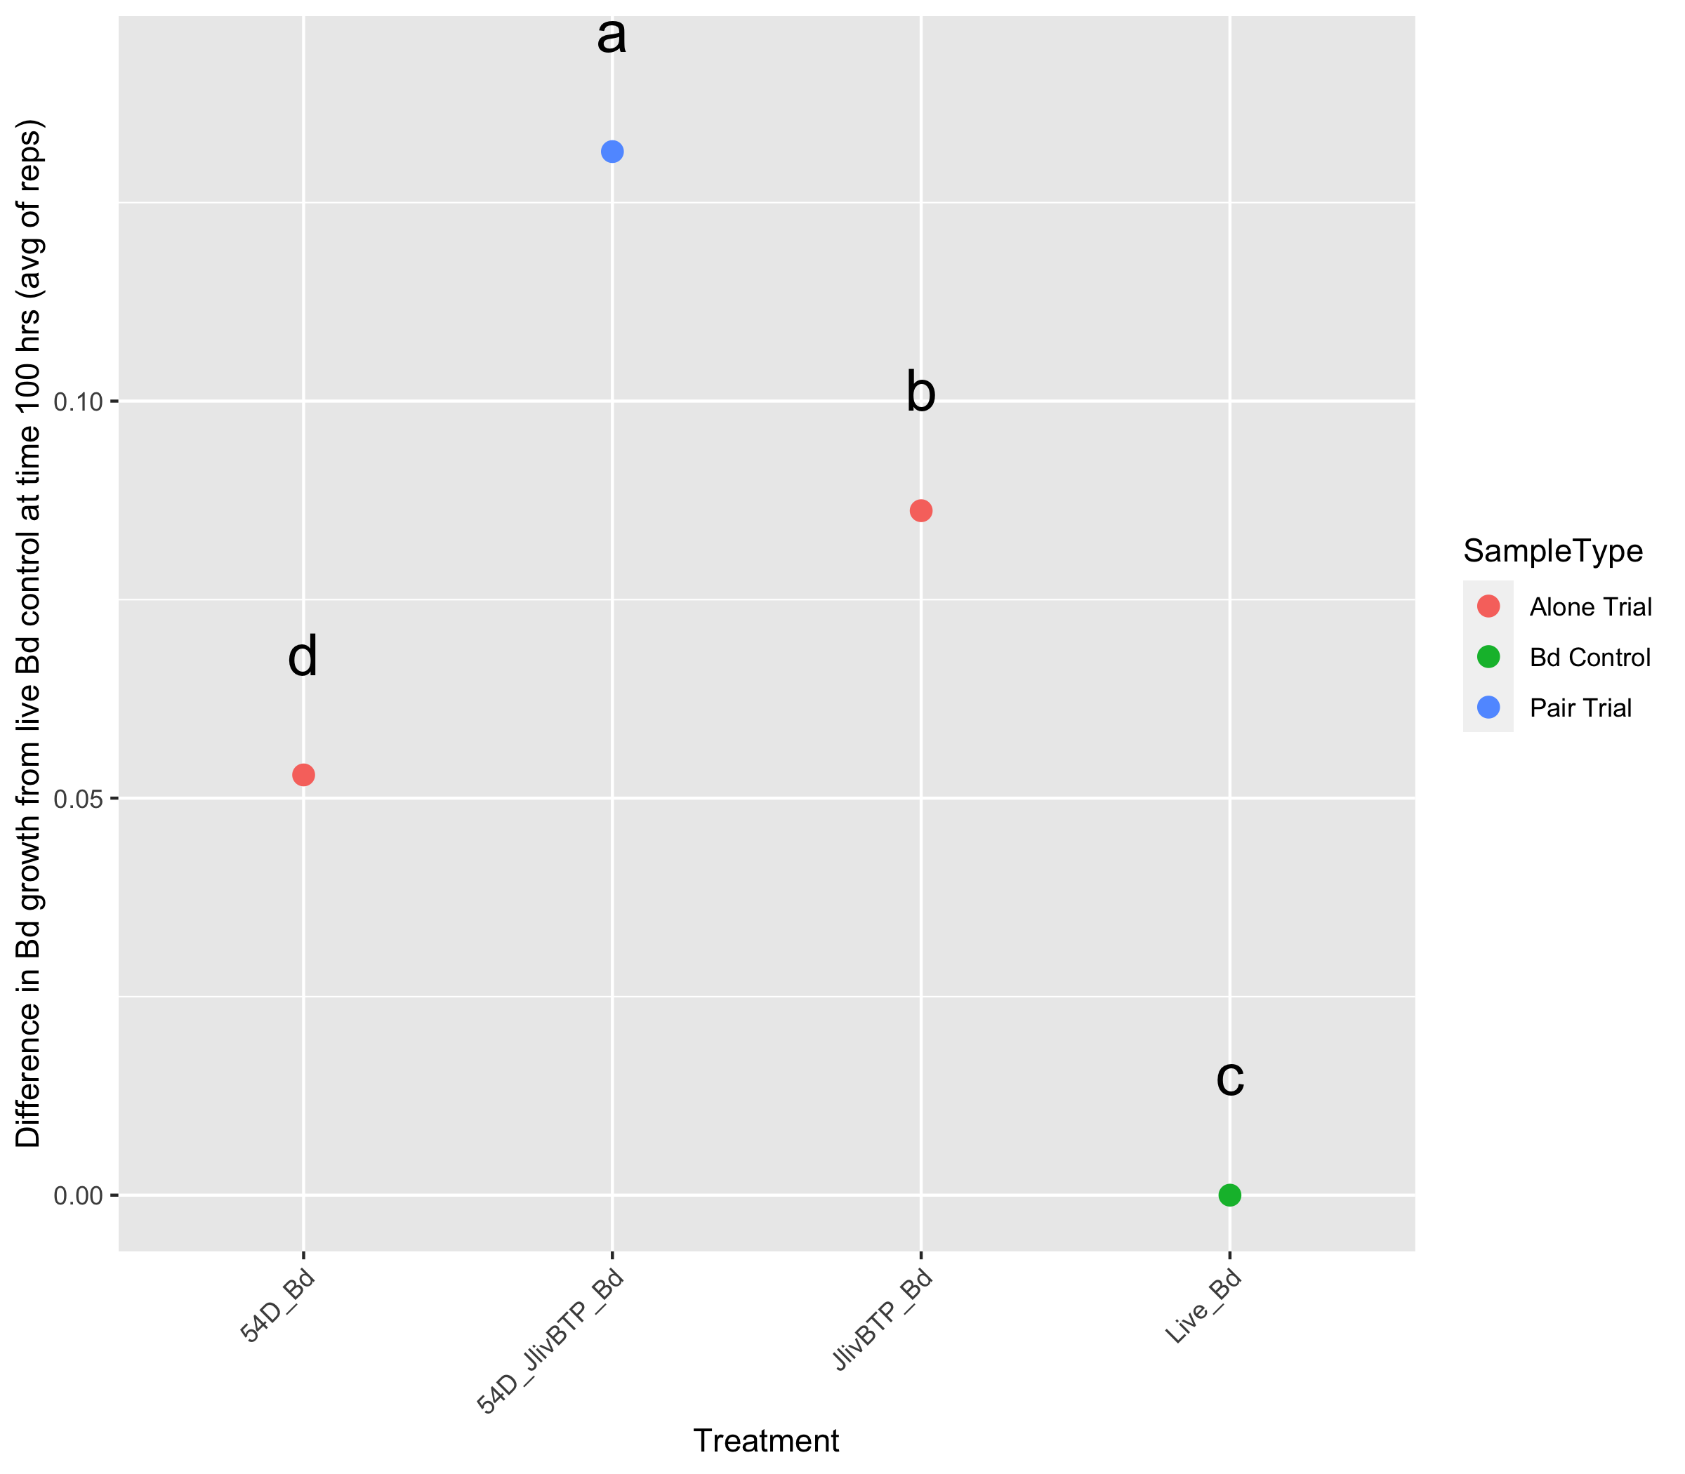
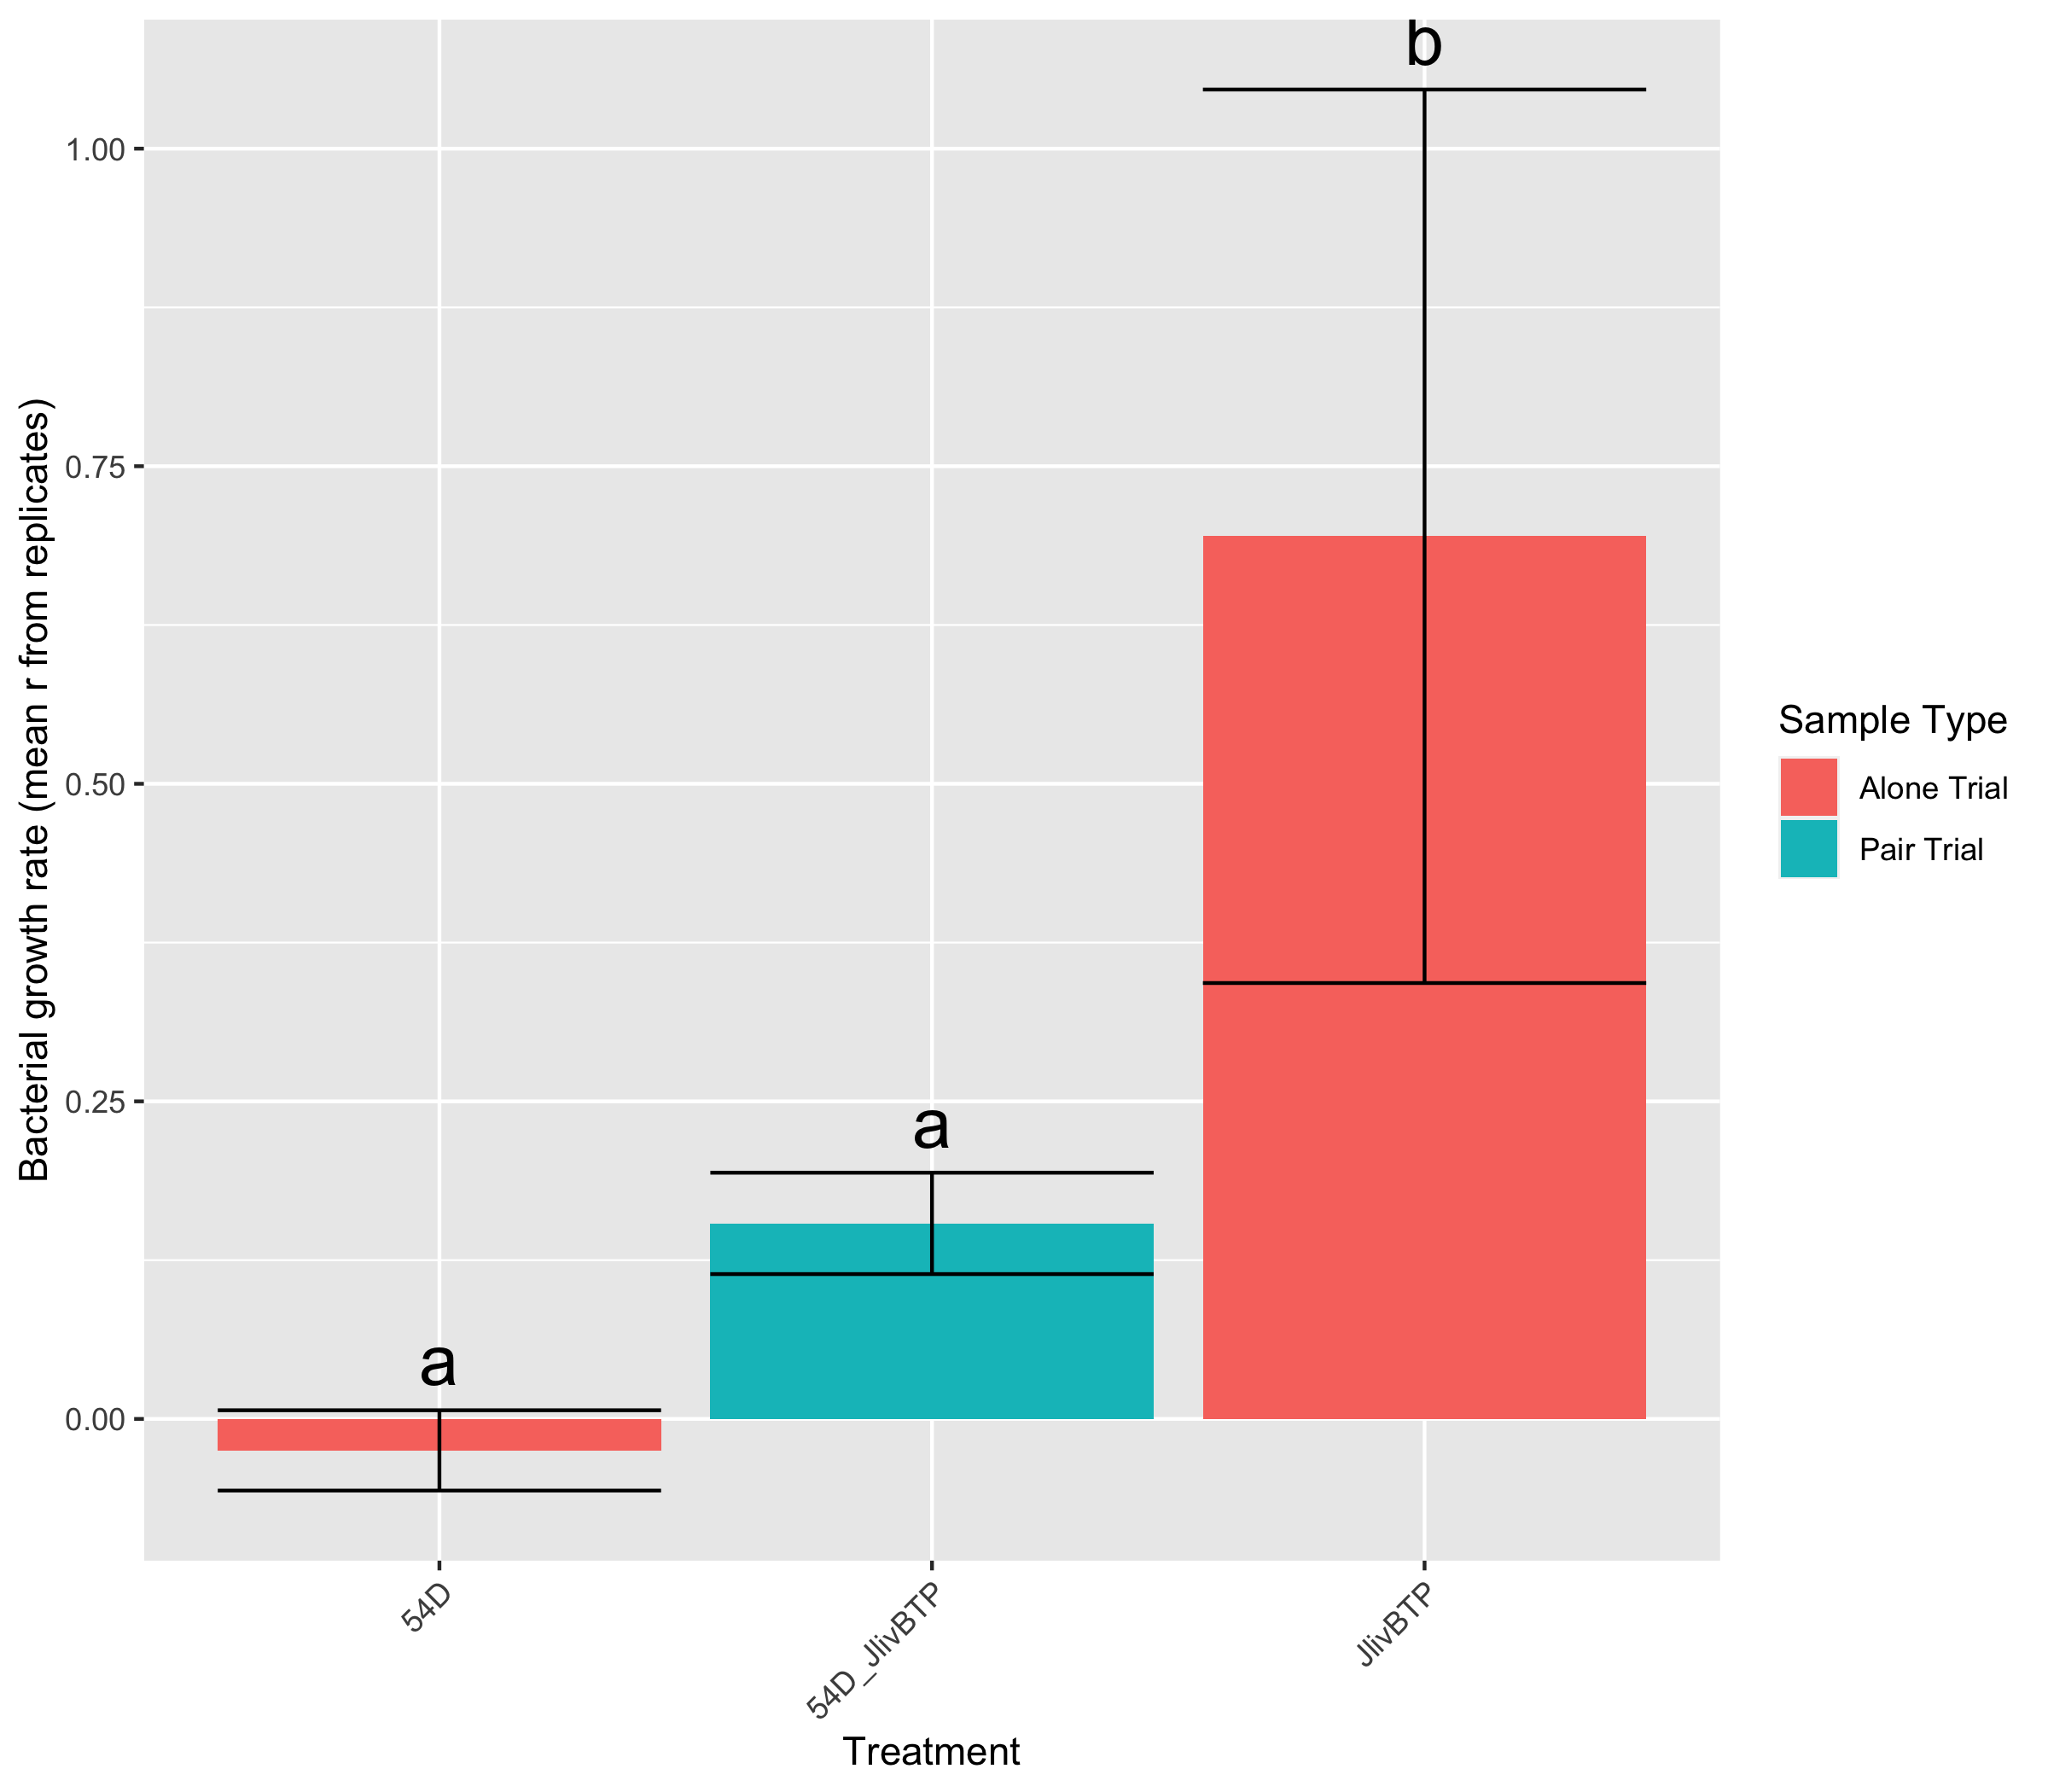
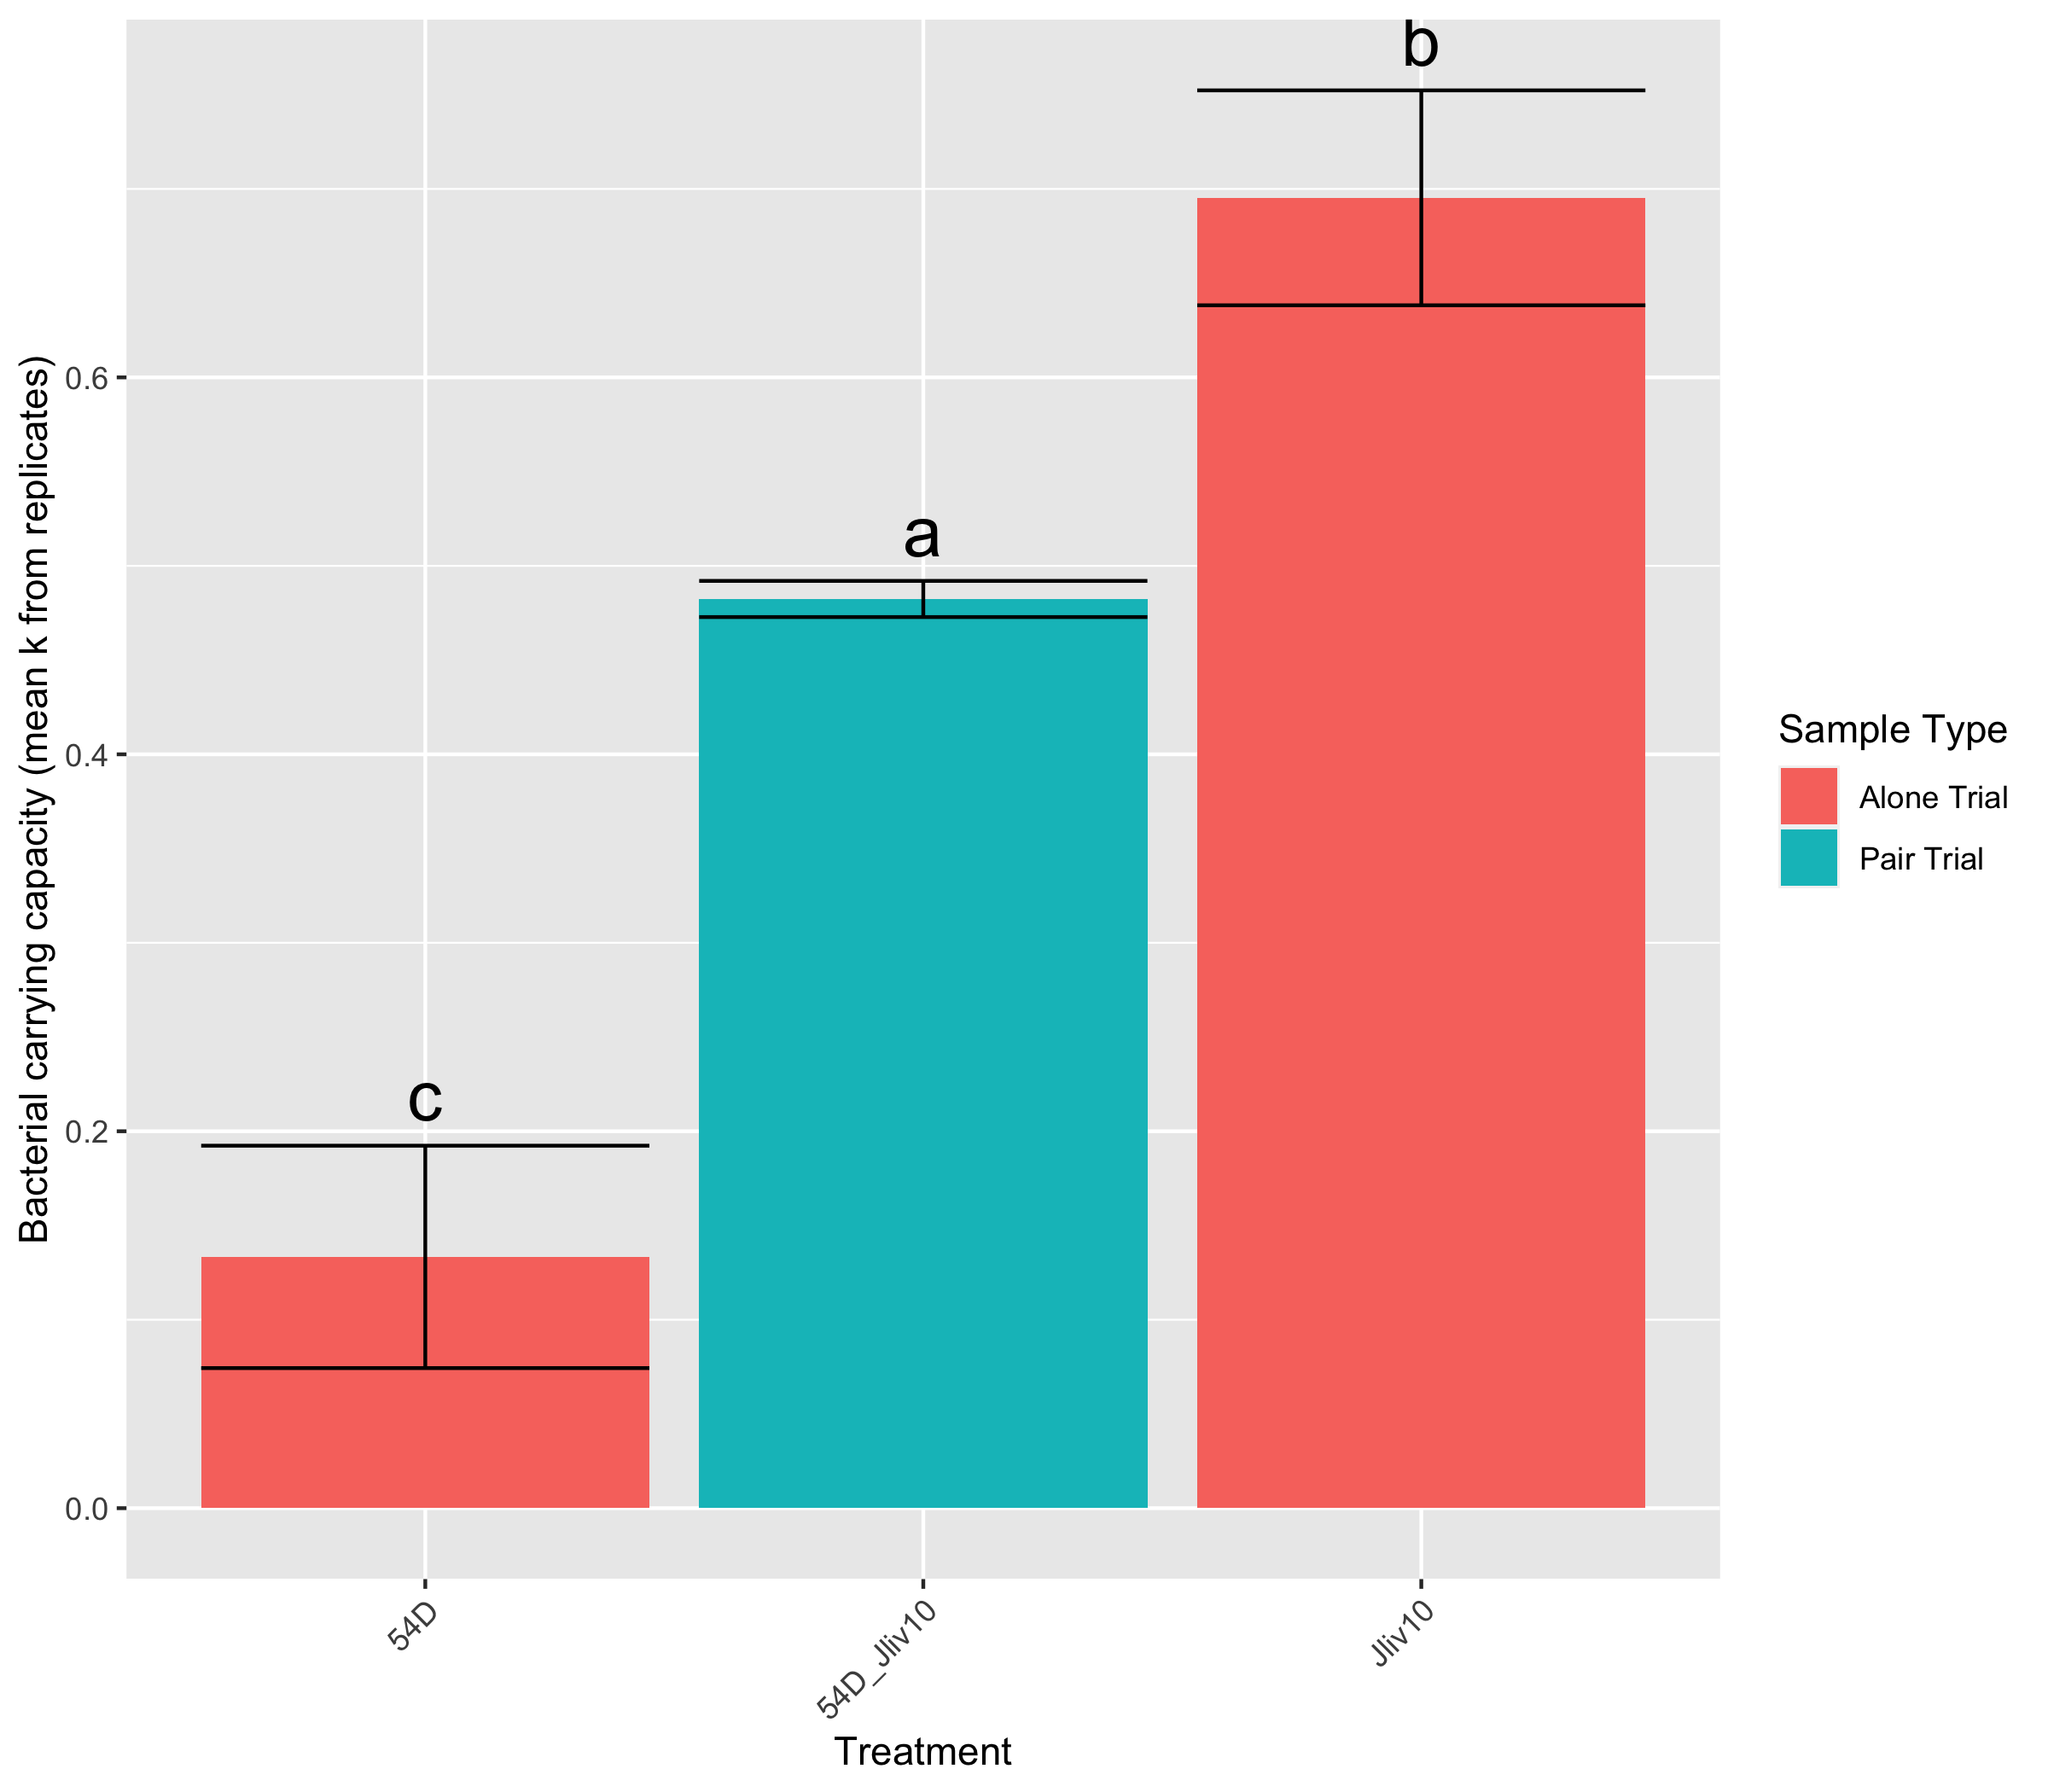
A
B
C
Burkholdariales (sps. unk.)
Burkholdariales (sps. unk.) and J. lividum (str-BTP)
J. lividum (str-BTP)
Live Bd
Burkholdariales (sps. unk.)
Burkholdariales (sps. unk.) and J. lividum (str-BTP)
J. lividum (str-BTP)
Burkholdariales (sps. unk.)
Burkholdariales (sps. unk.) and J. lividum (str-Jliv10)
J. lividum (str-BTP)

Slide 7
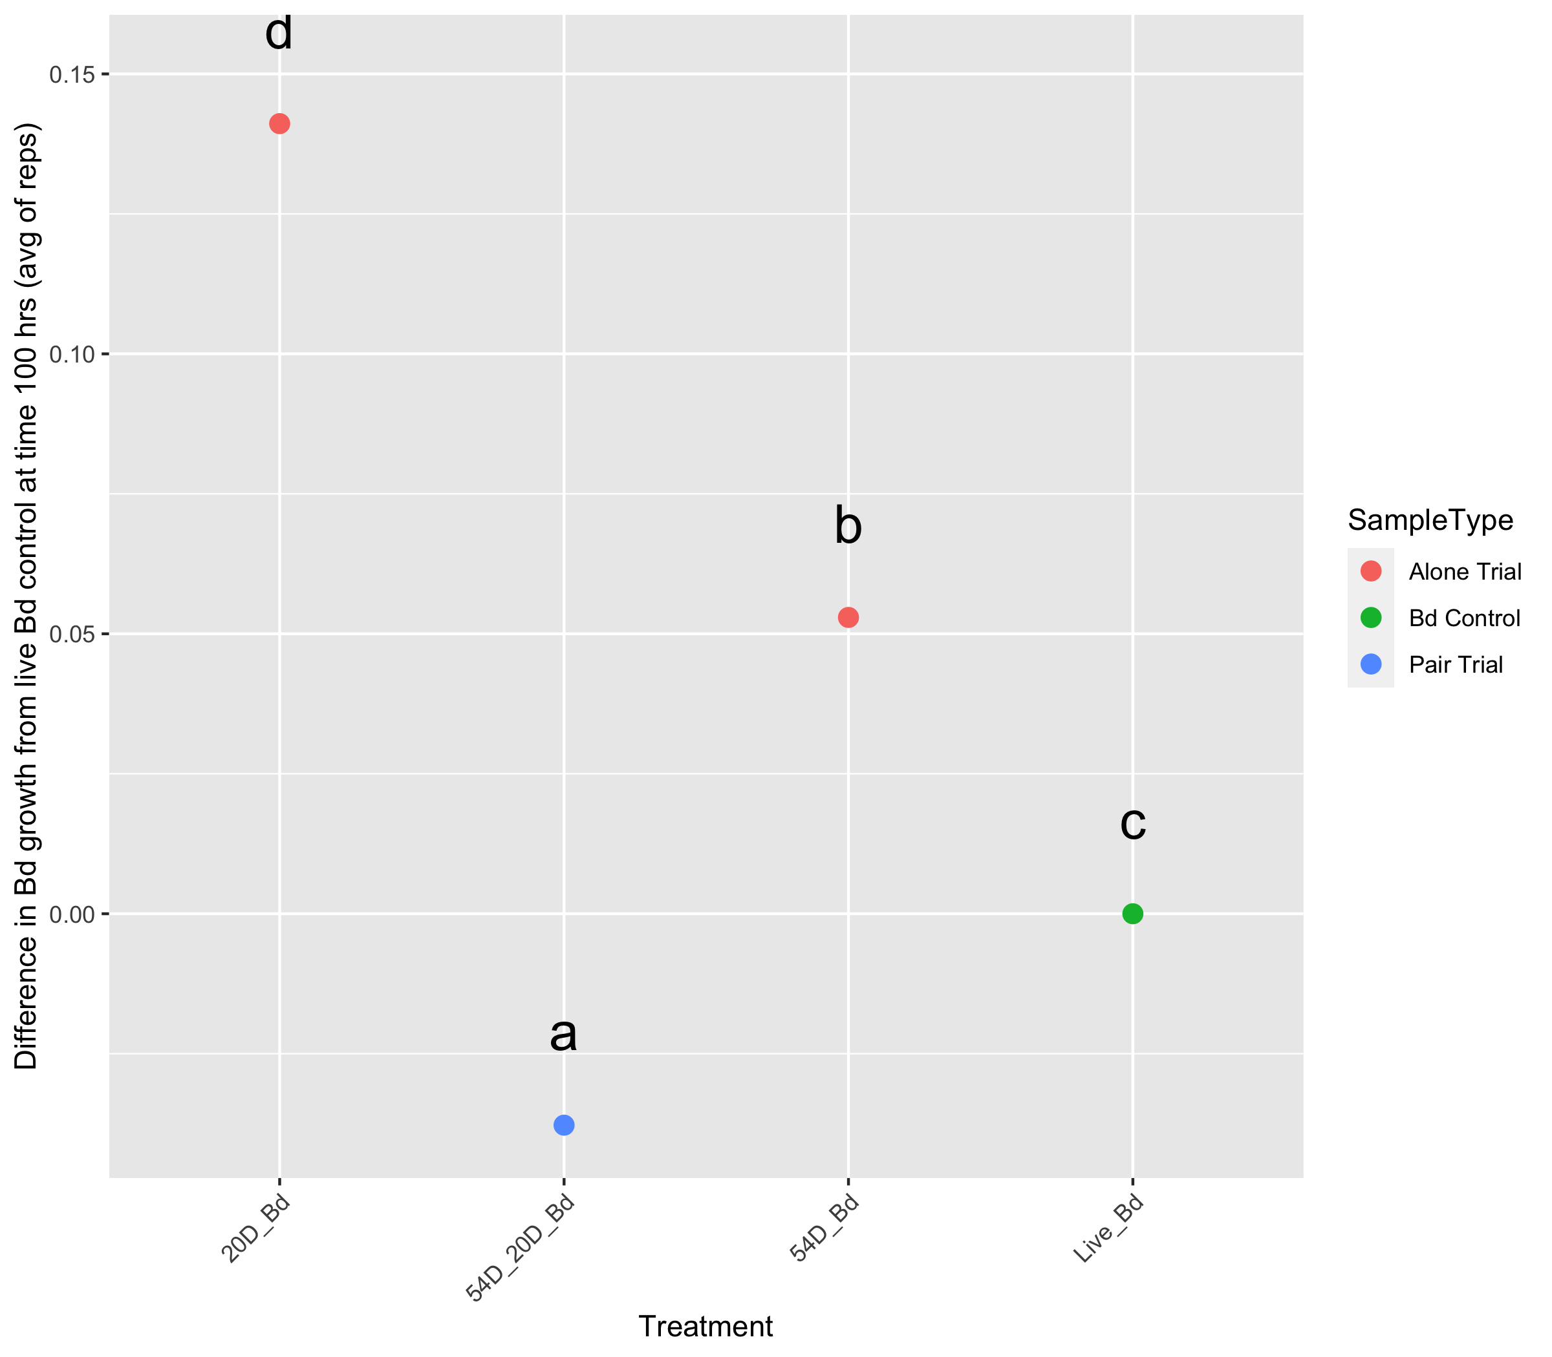
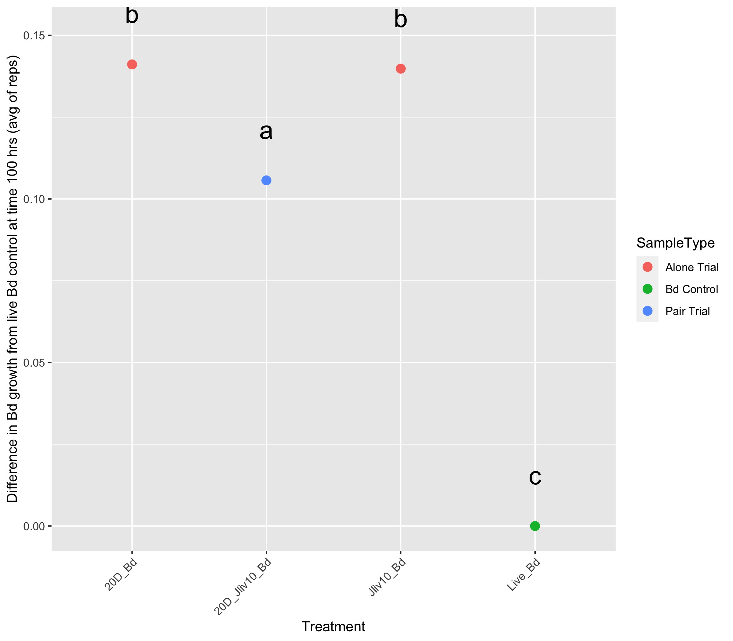
A
B
Chryseobacterium sp.
Chryseobacterium sp.
and Burkholdariales (sps. unk.)
Burkholdariales (sps. unk.)
Live Bd
Chryseobacterium sp.
Chryseobacterium sp.
and J. lividum (str-Jliv10)
J. lividum (str-Jliv10)
Live Bd

Slide 8
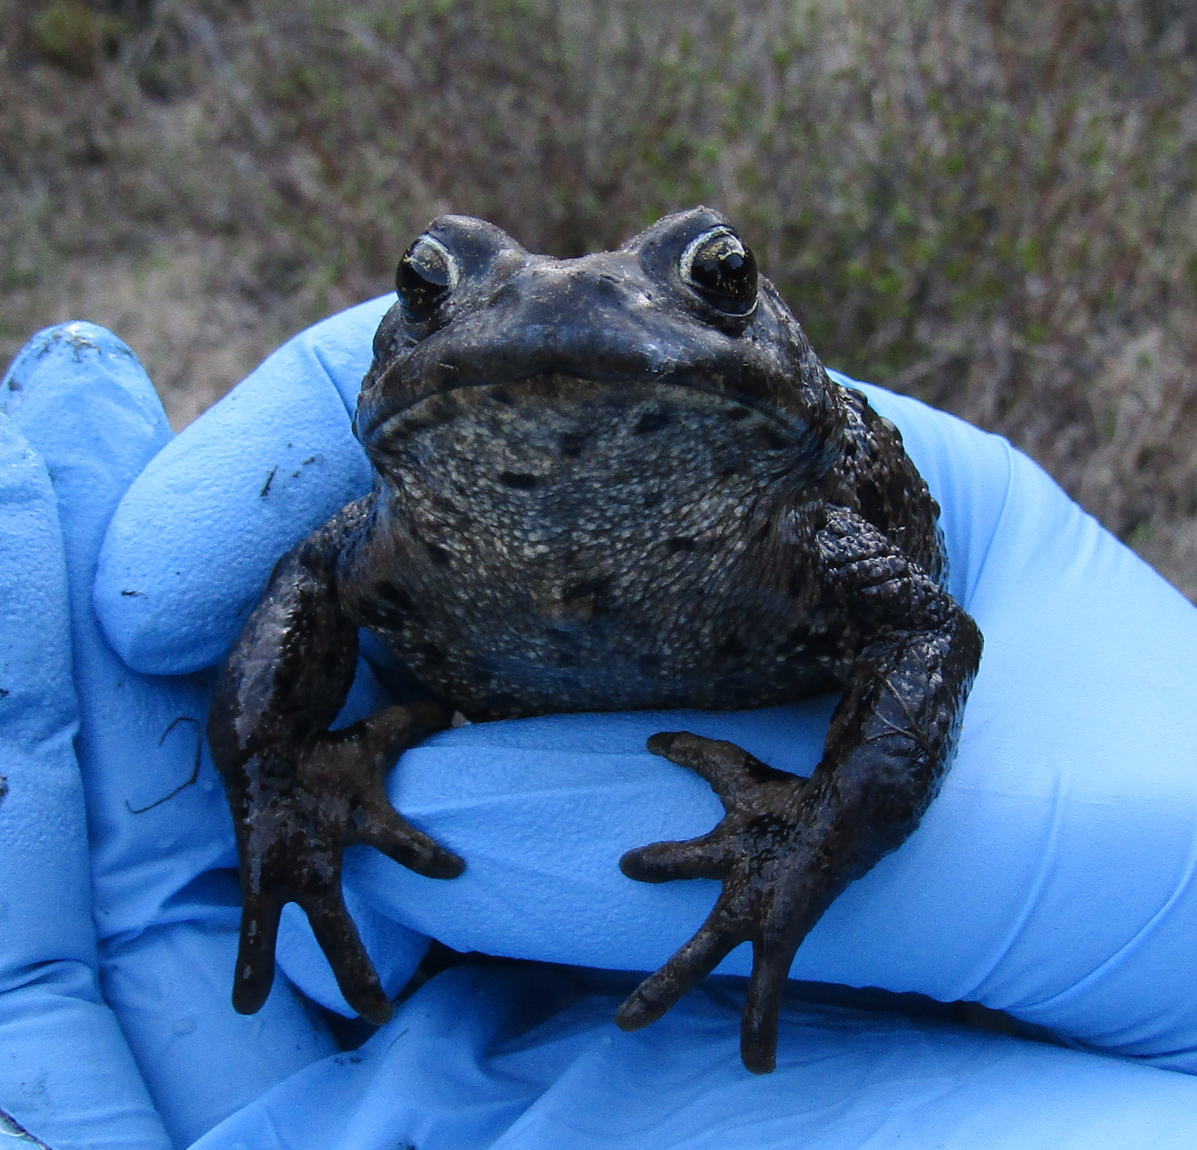
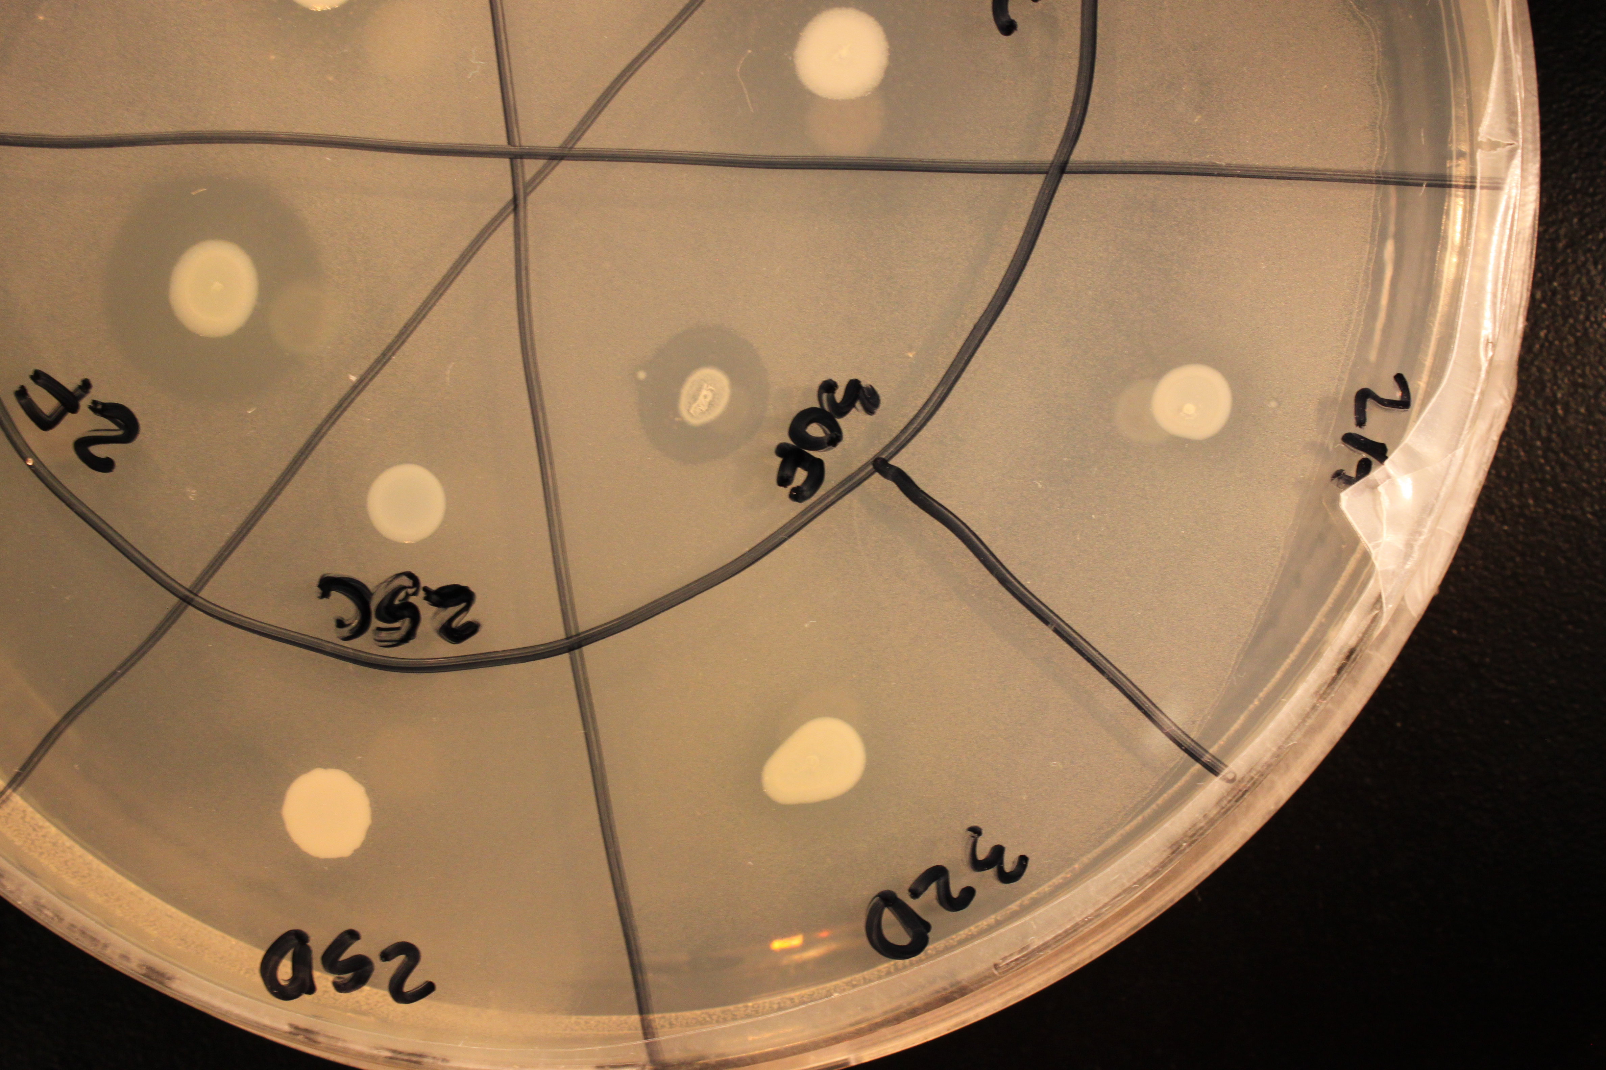

Slide 9


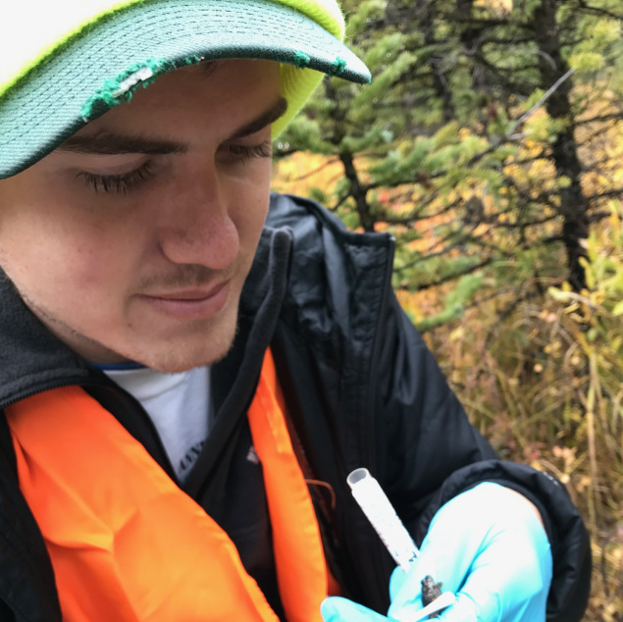


Slide 10
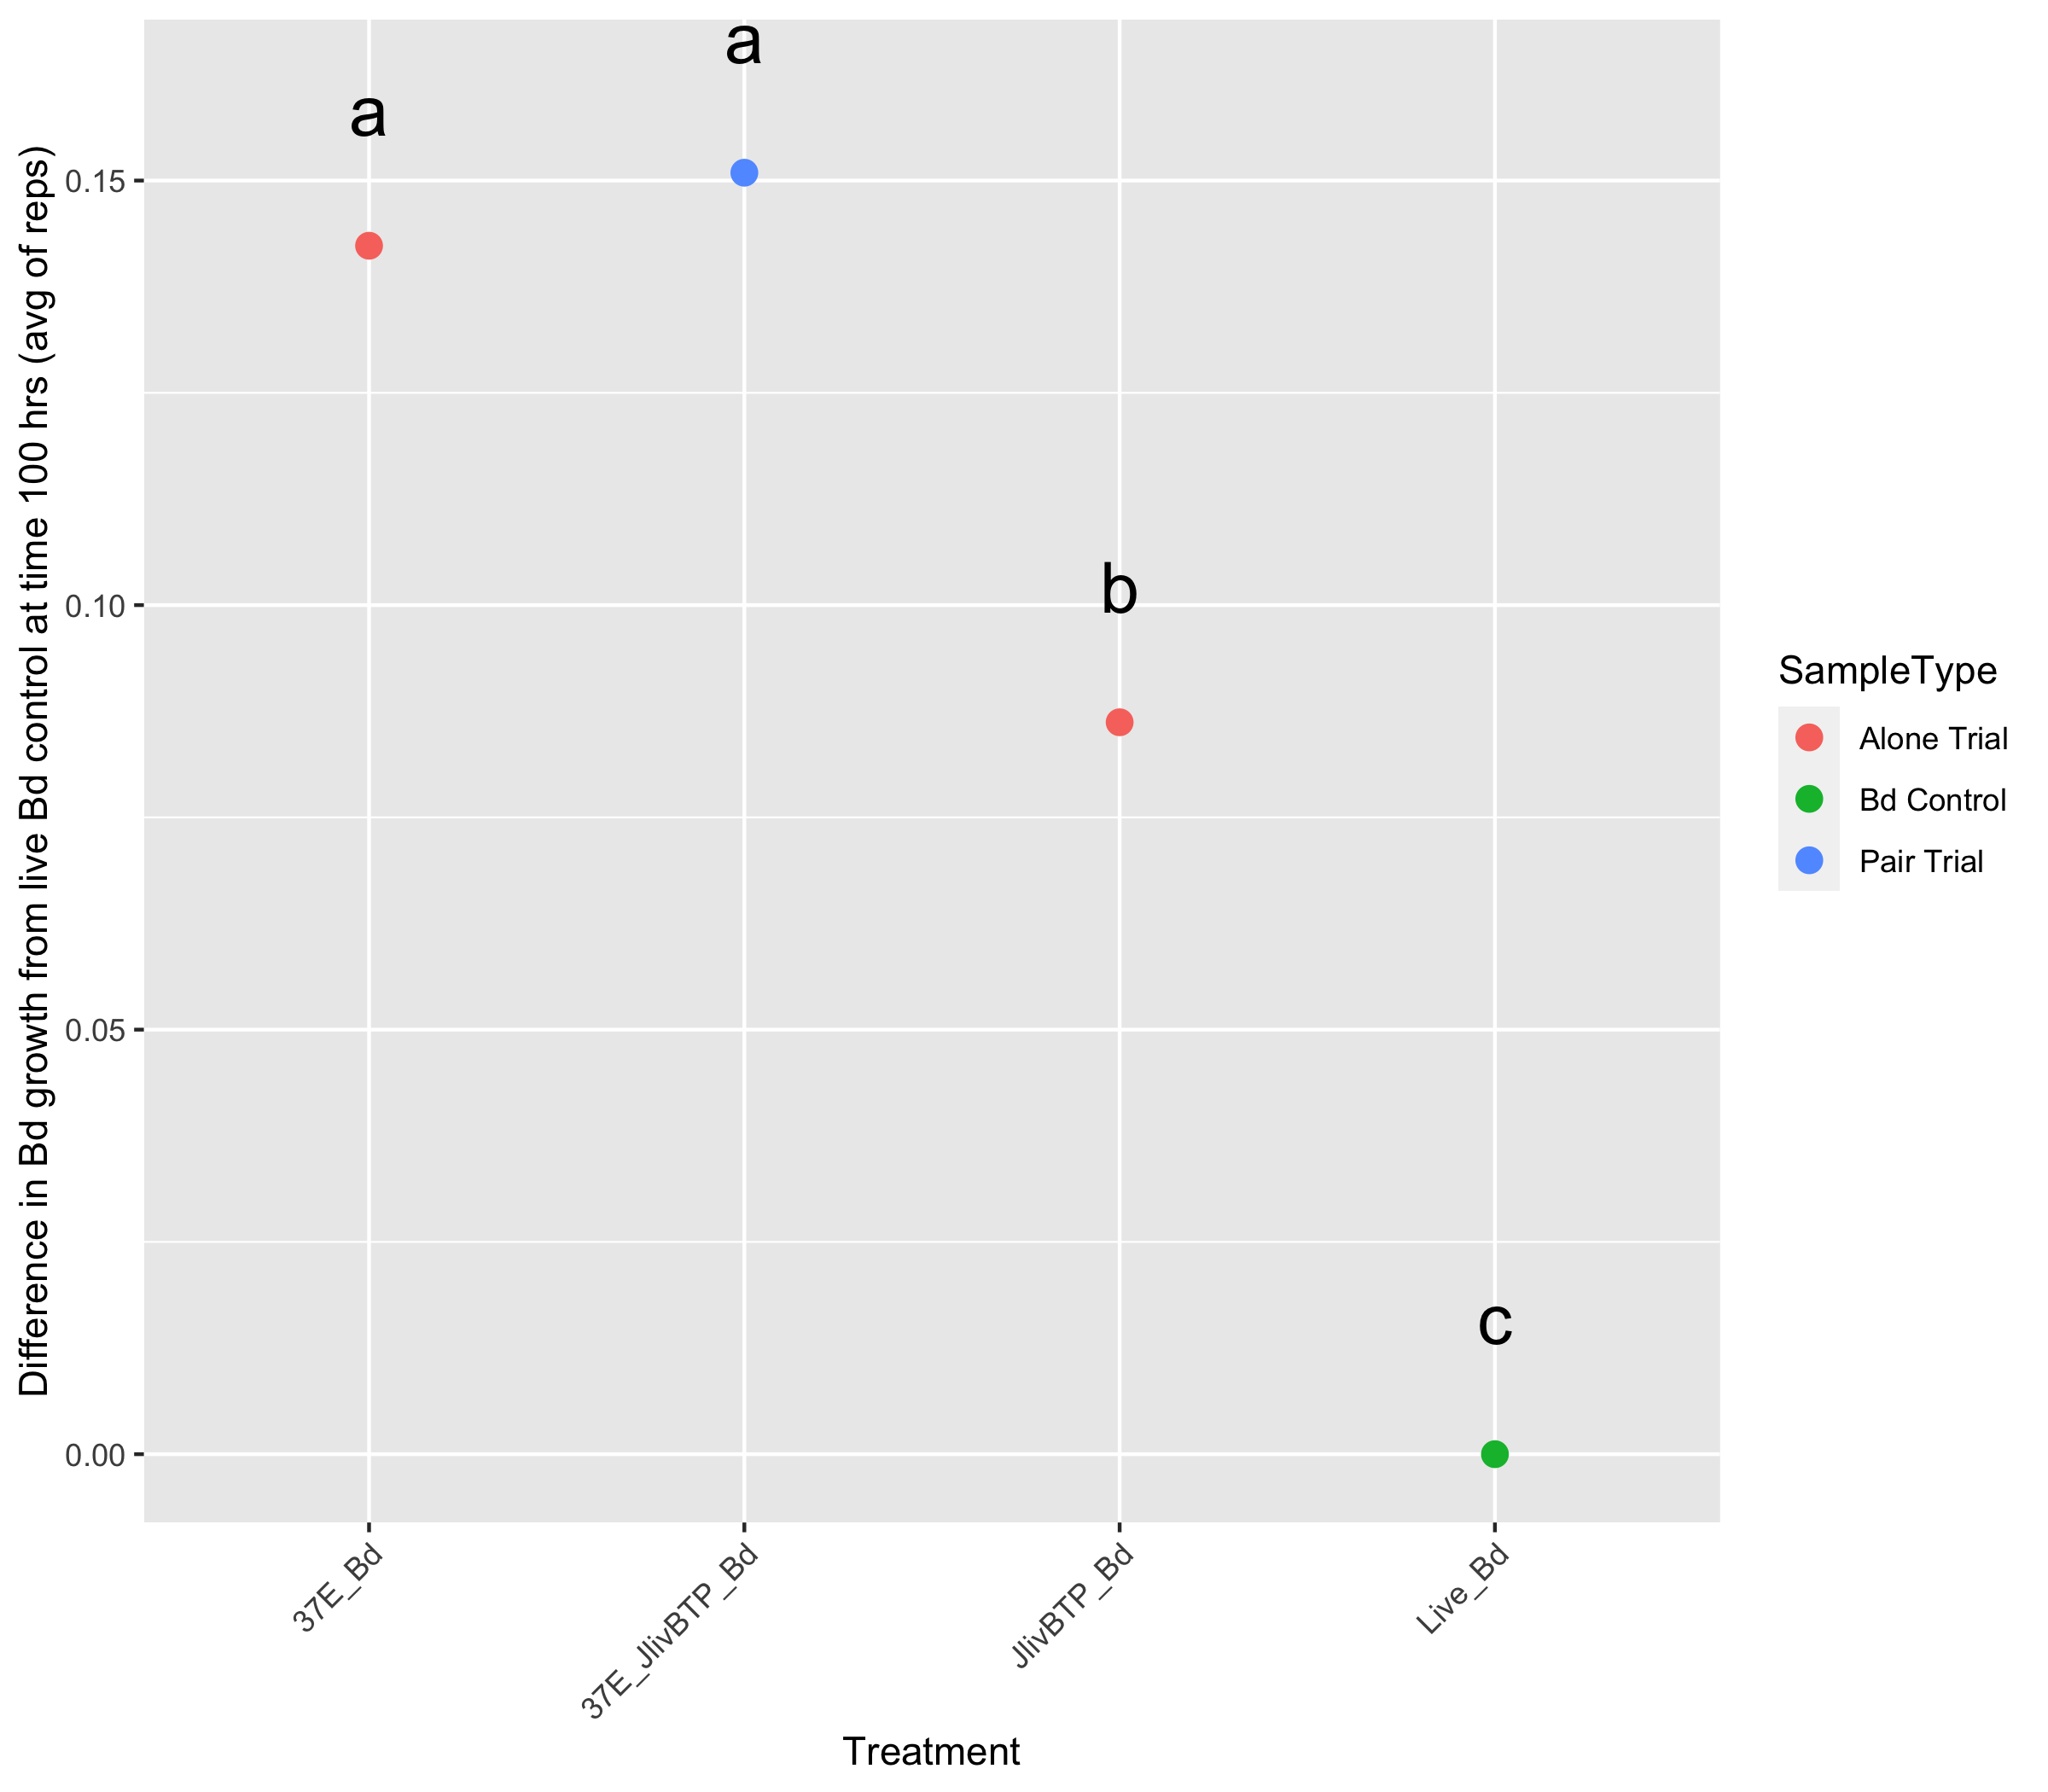
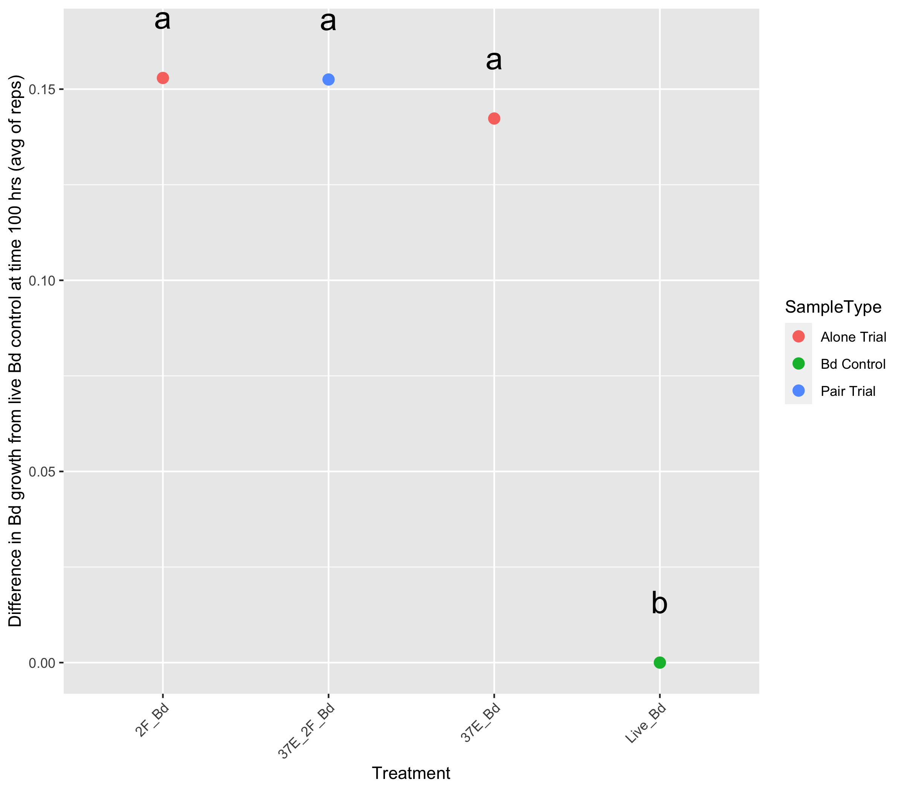
Additive
Highly antagonistic
Rest were all antagonistic
Increasing Bd inhibition
Chryseobacterium
Burkholdariales and Chryseobacterium
Burkholdariales
Live Bd
Microbacterium
Burkholdariales and Microbacterium
Burkholdariales
Live Bd
Burkholdariales
Burkholdariales and Jliv BTP
Jliv BTP
Live Bd
Chryseobacterium
Jliv 10 and Chryseobacterium
Jliv 10
Live Bd
Pseudomonas
Pseudomonas and Microbacterium
Microbacterium
Live Bd

Slide 11
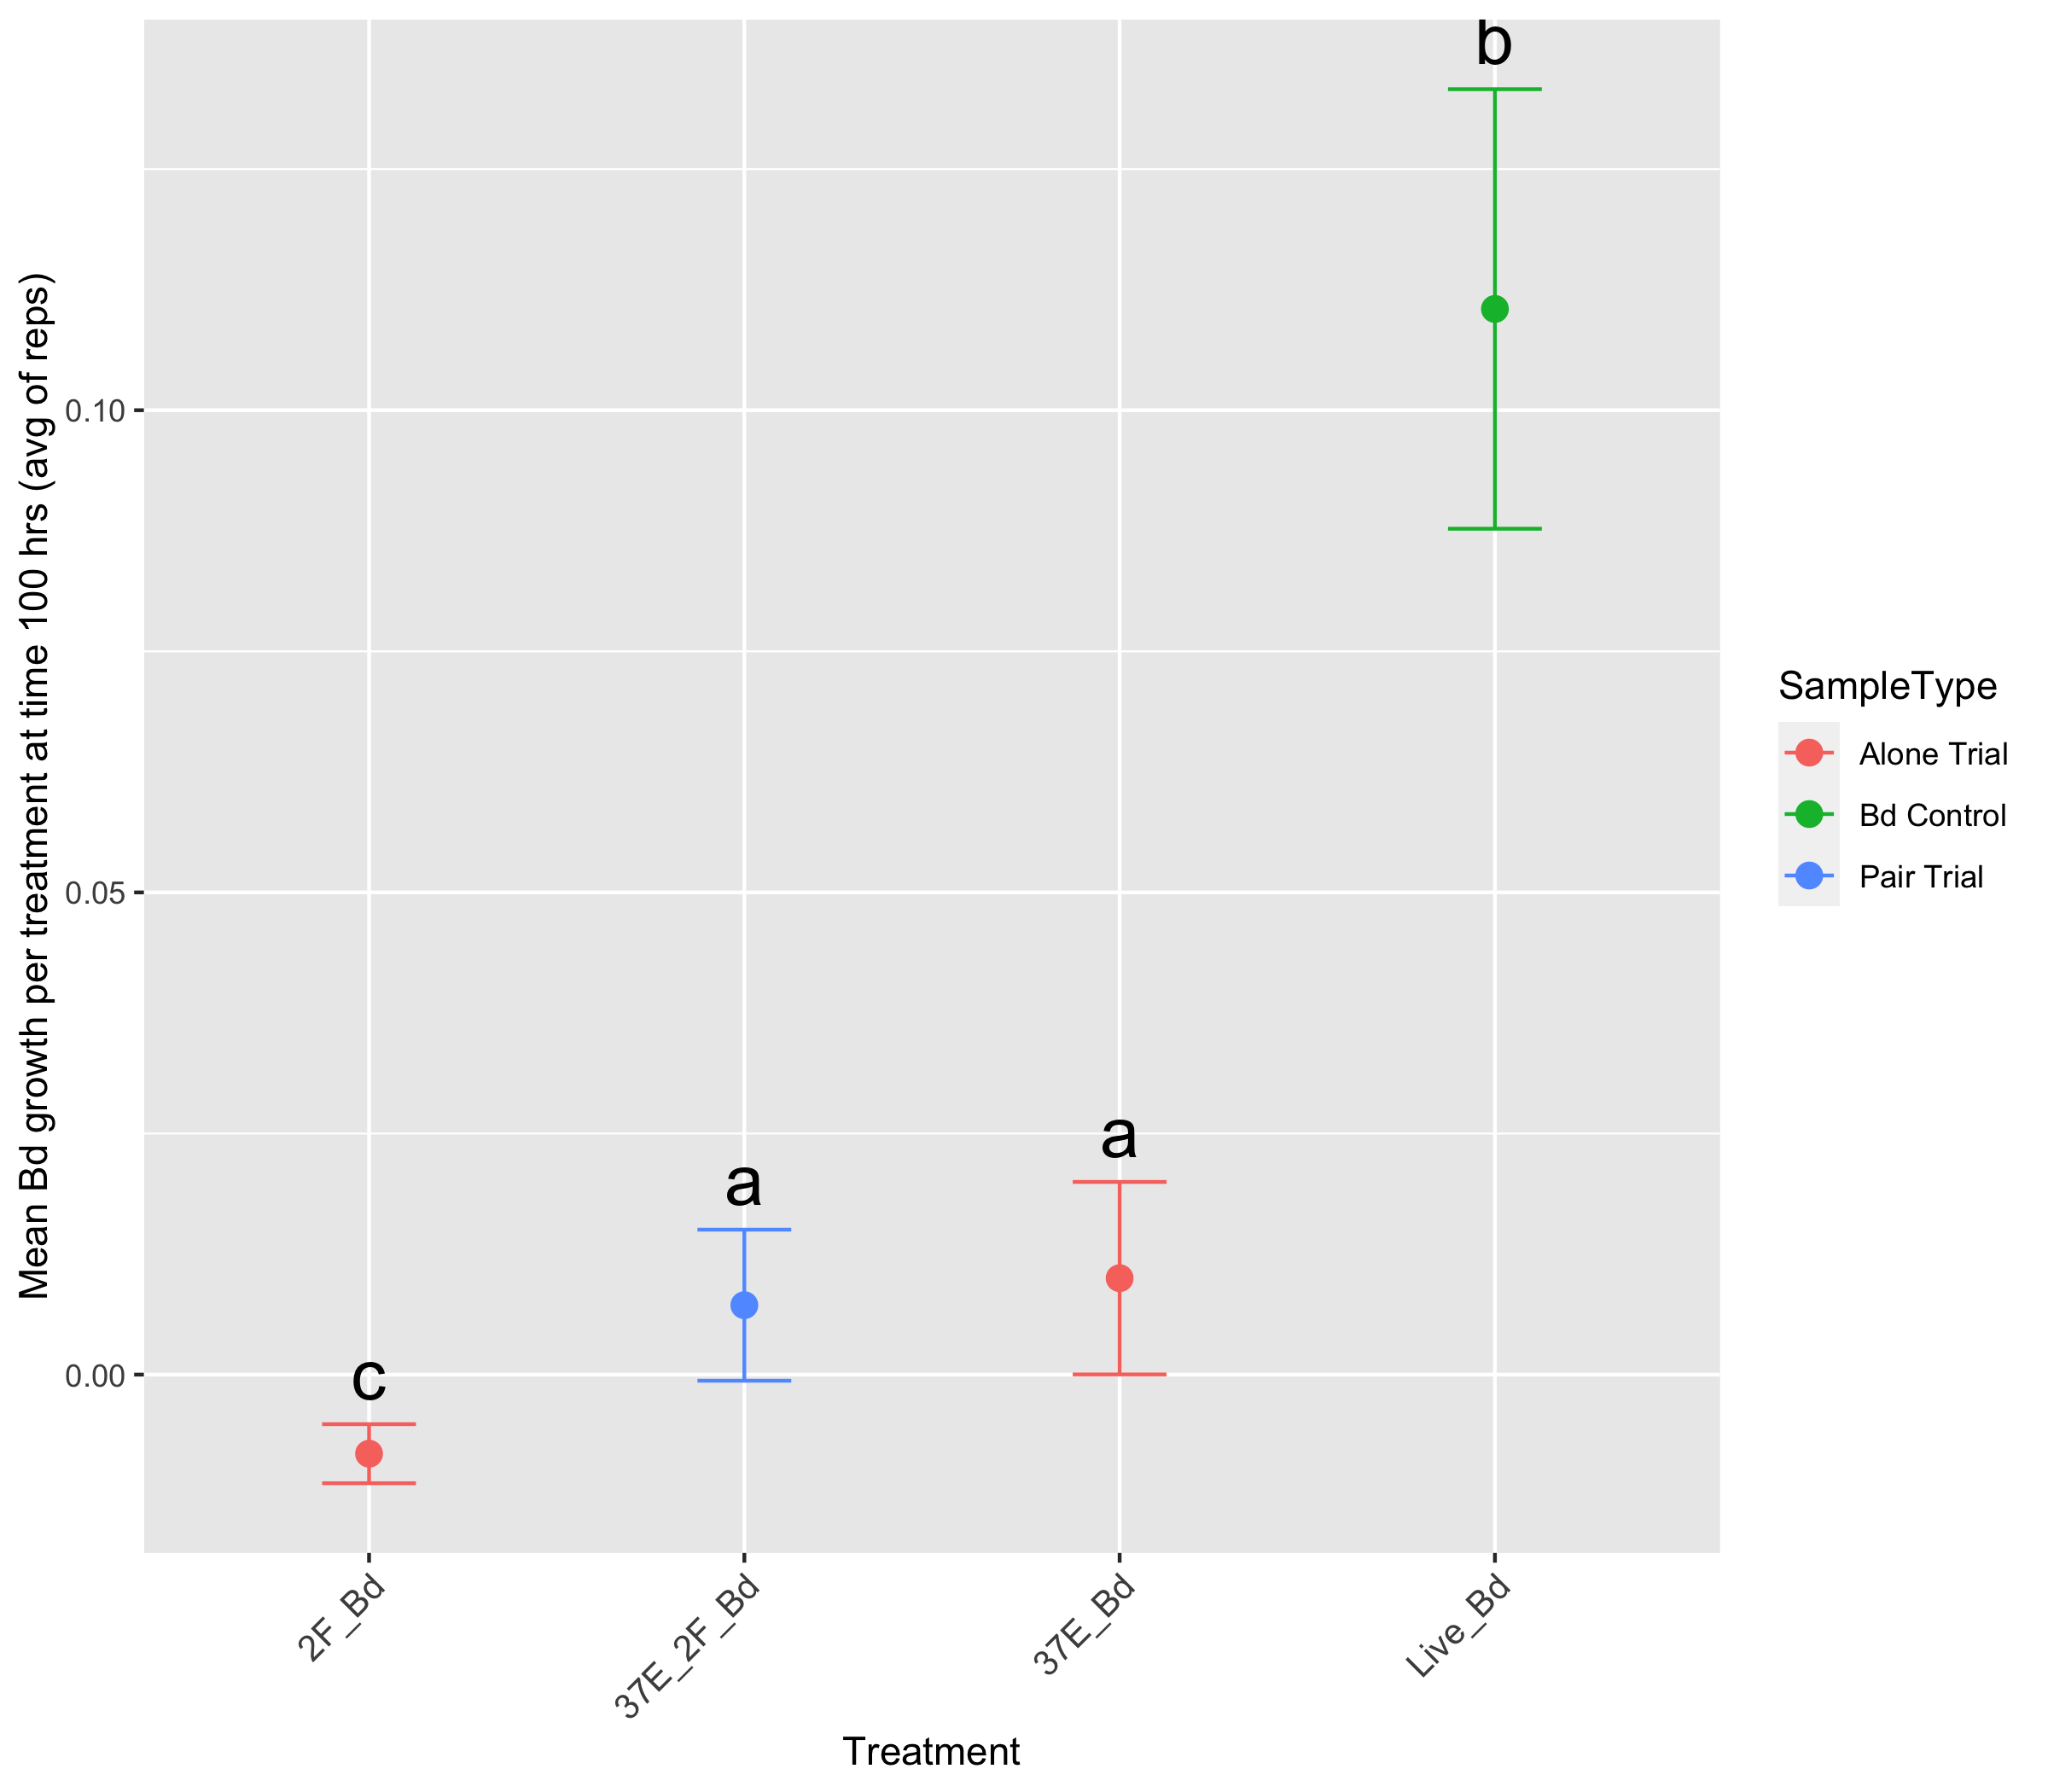
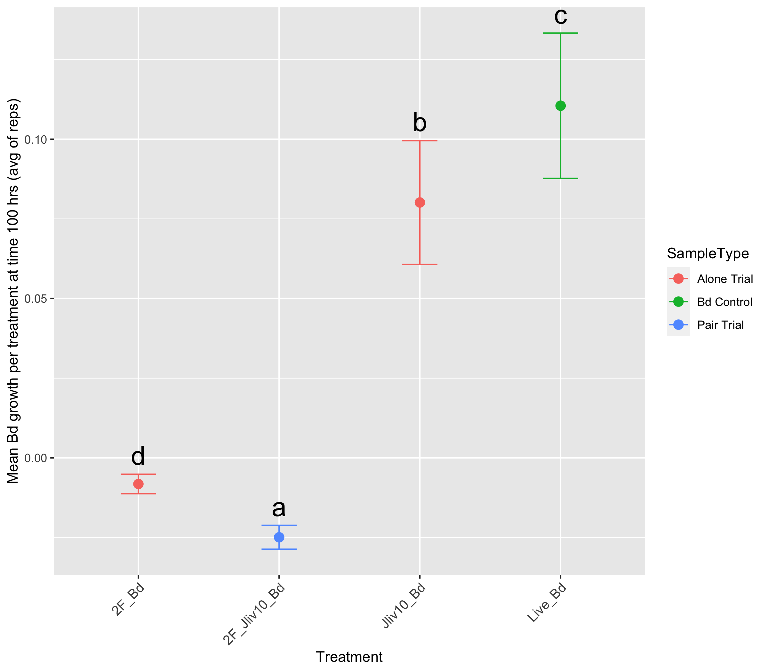
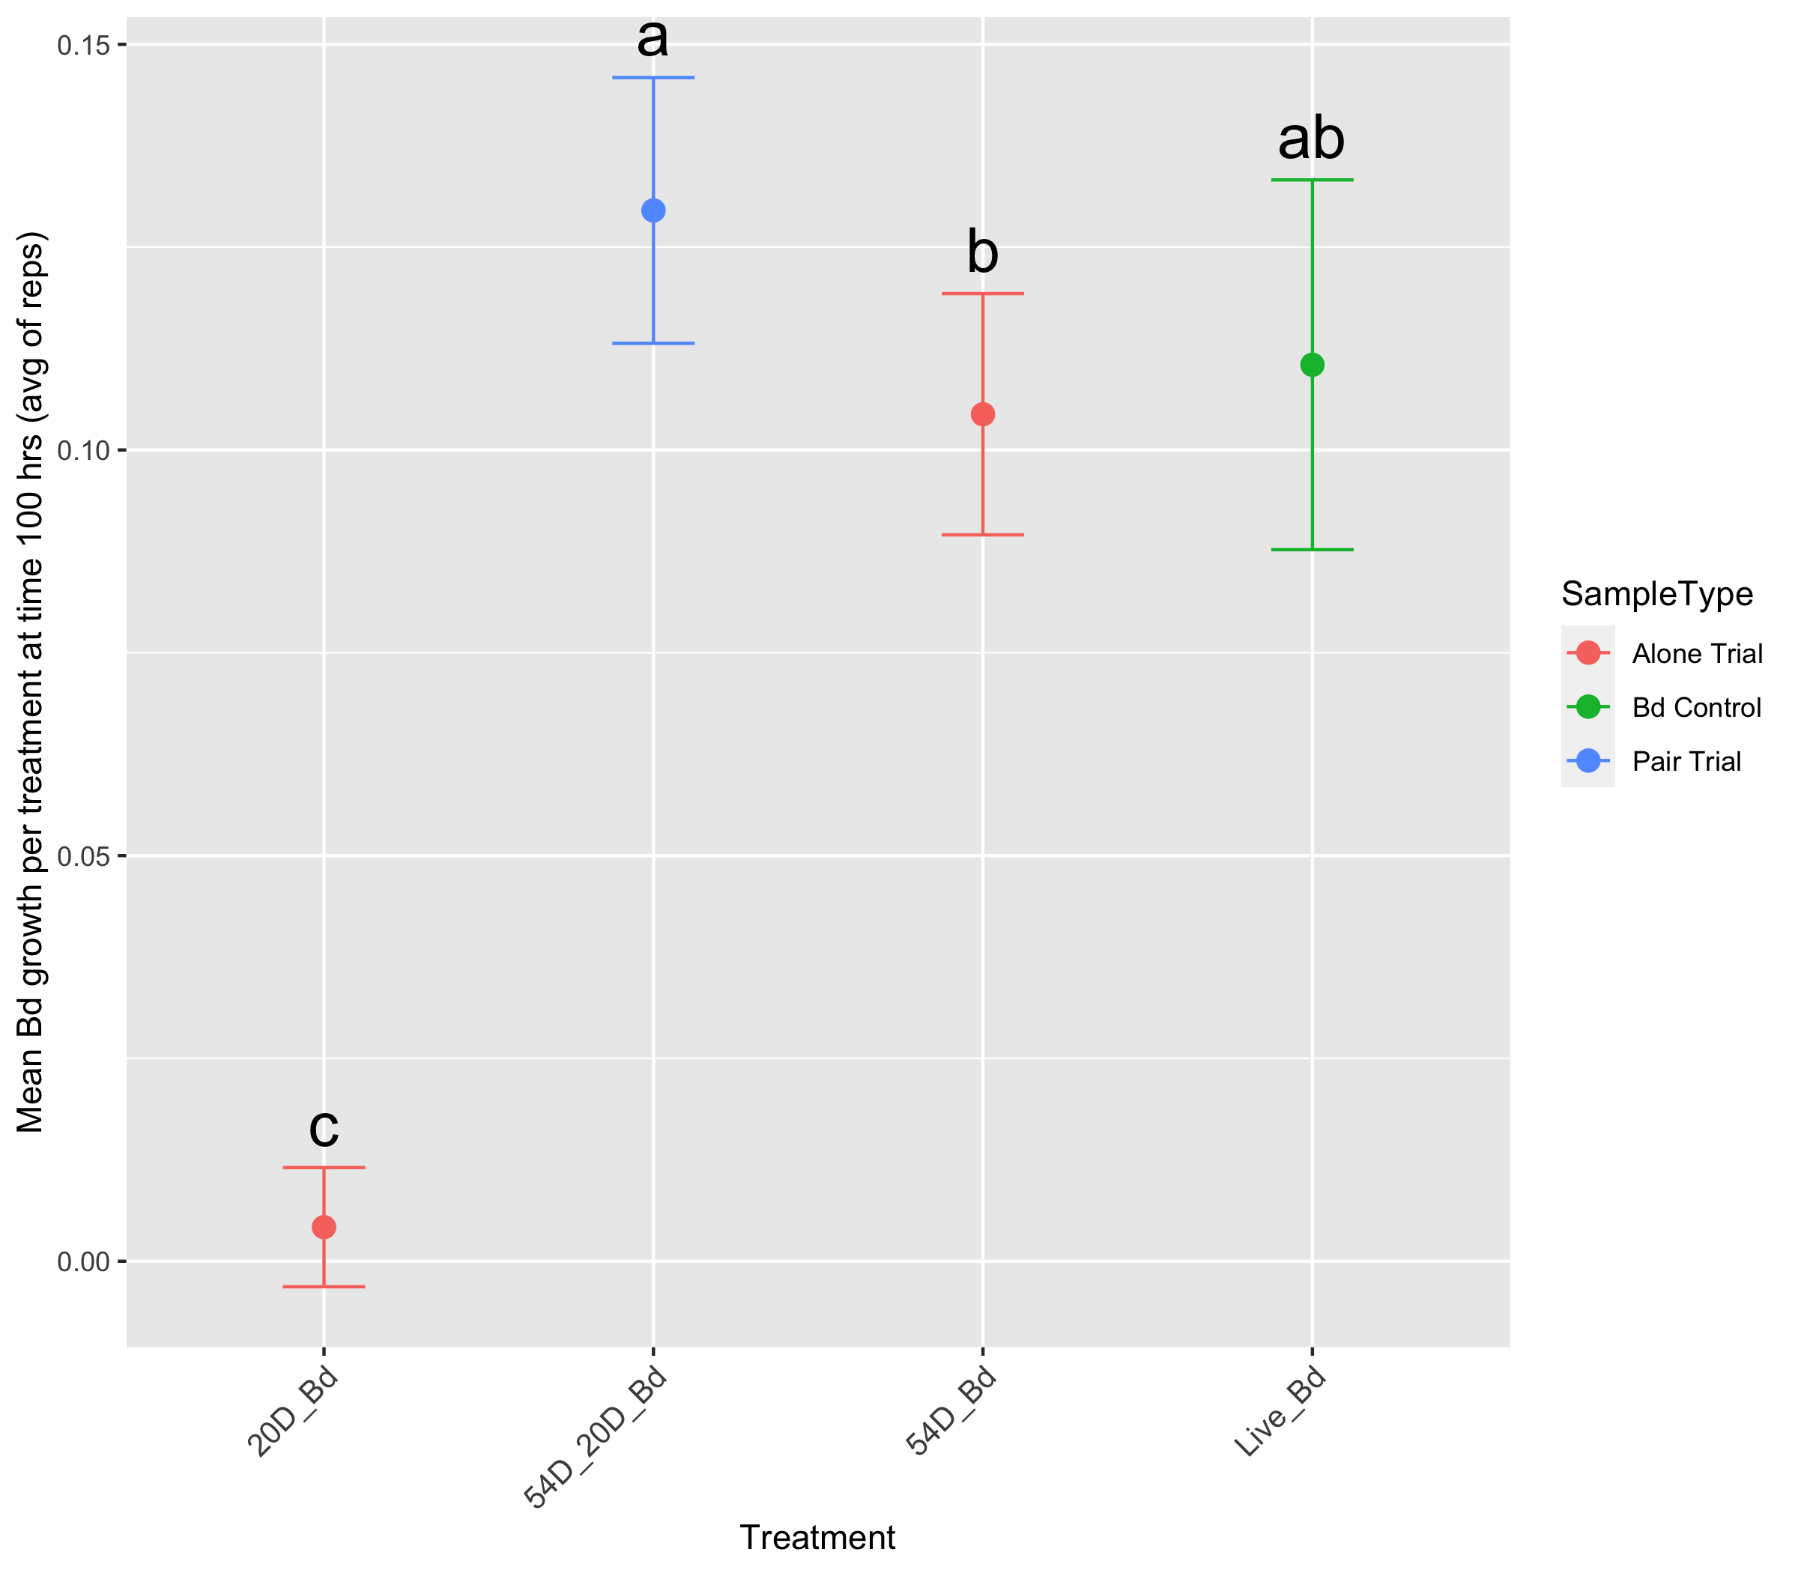
One microbe is better than the other and the pair
One microbe and the pair is better than the other
Pair of microbes better than either alone
Bd inhibition
Pseudomonas
Pseudomonas and Microbacterium
Microbacterium
Live Bd
Burkholdariales
Burkholdariales and Jliv BTP
Jliv BTP
Live Bd
Pseudomonas
Pseudomonas and Jliv 10
Jliv 10
Live Bd
One microbe loses inhibition when paired
Bd promotion
Jliv 10
Jliv 10 and Jliv BTP
Jliv BTP
Live Bd
Burkholdariales
Burkholdariales and Jliv 10
Jliv 10
Live Bd
Chryseobacterium
Burkholdariales and Chryseobacterium
Burkholdariales
Live Bd

Slide 12
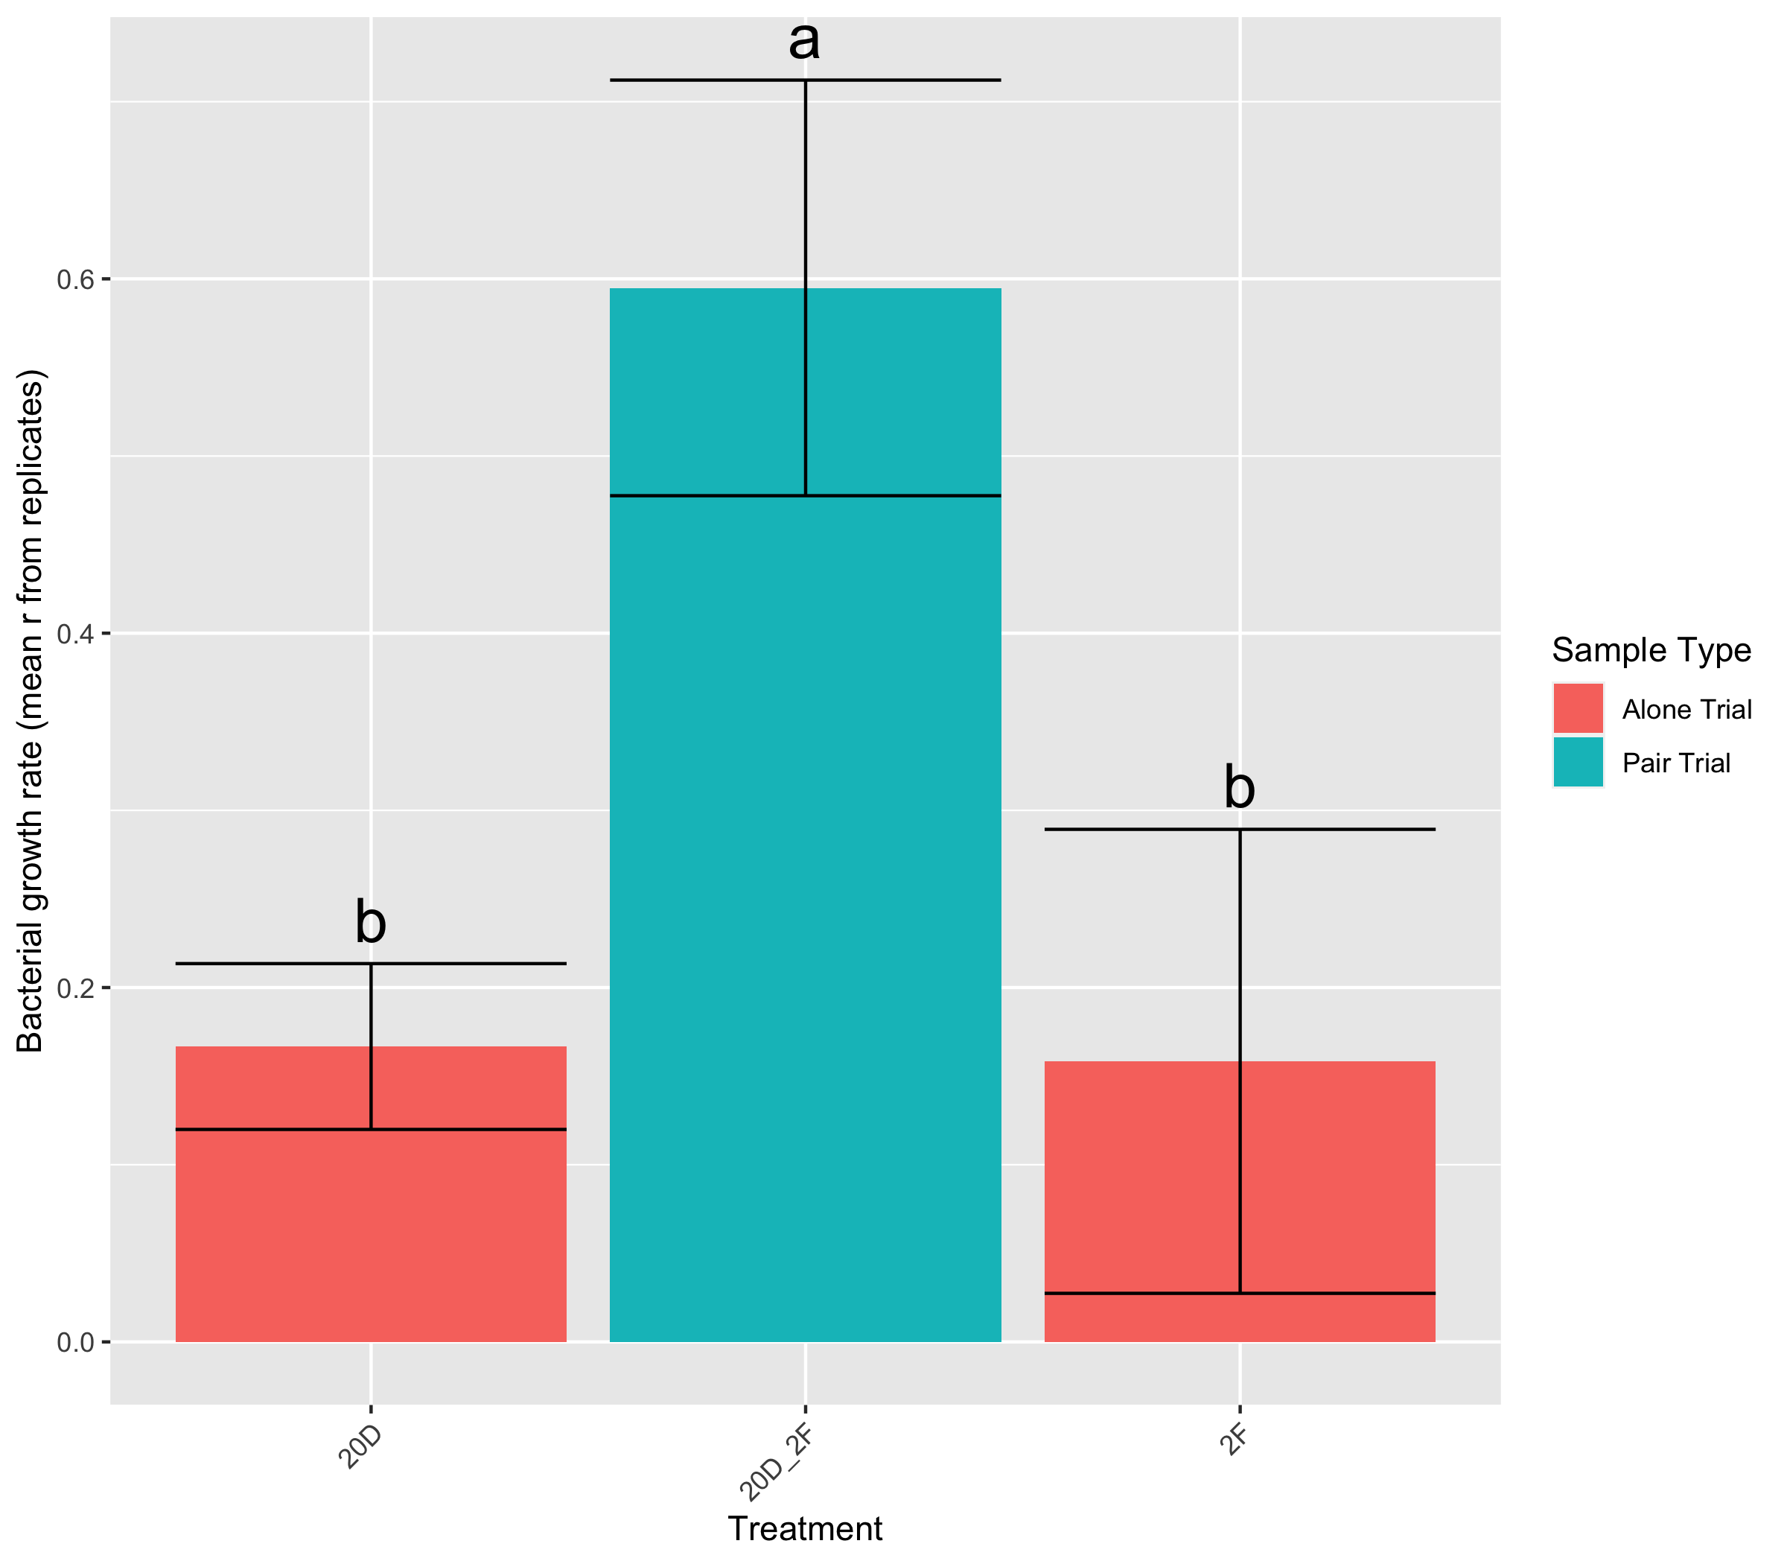
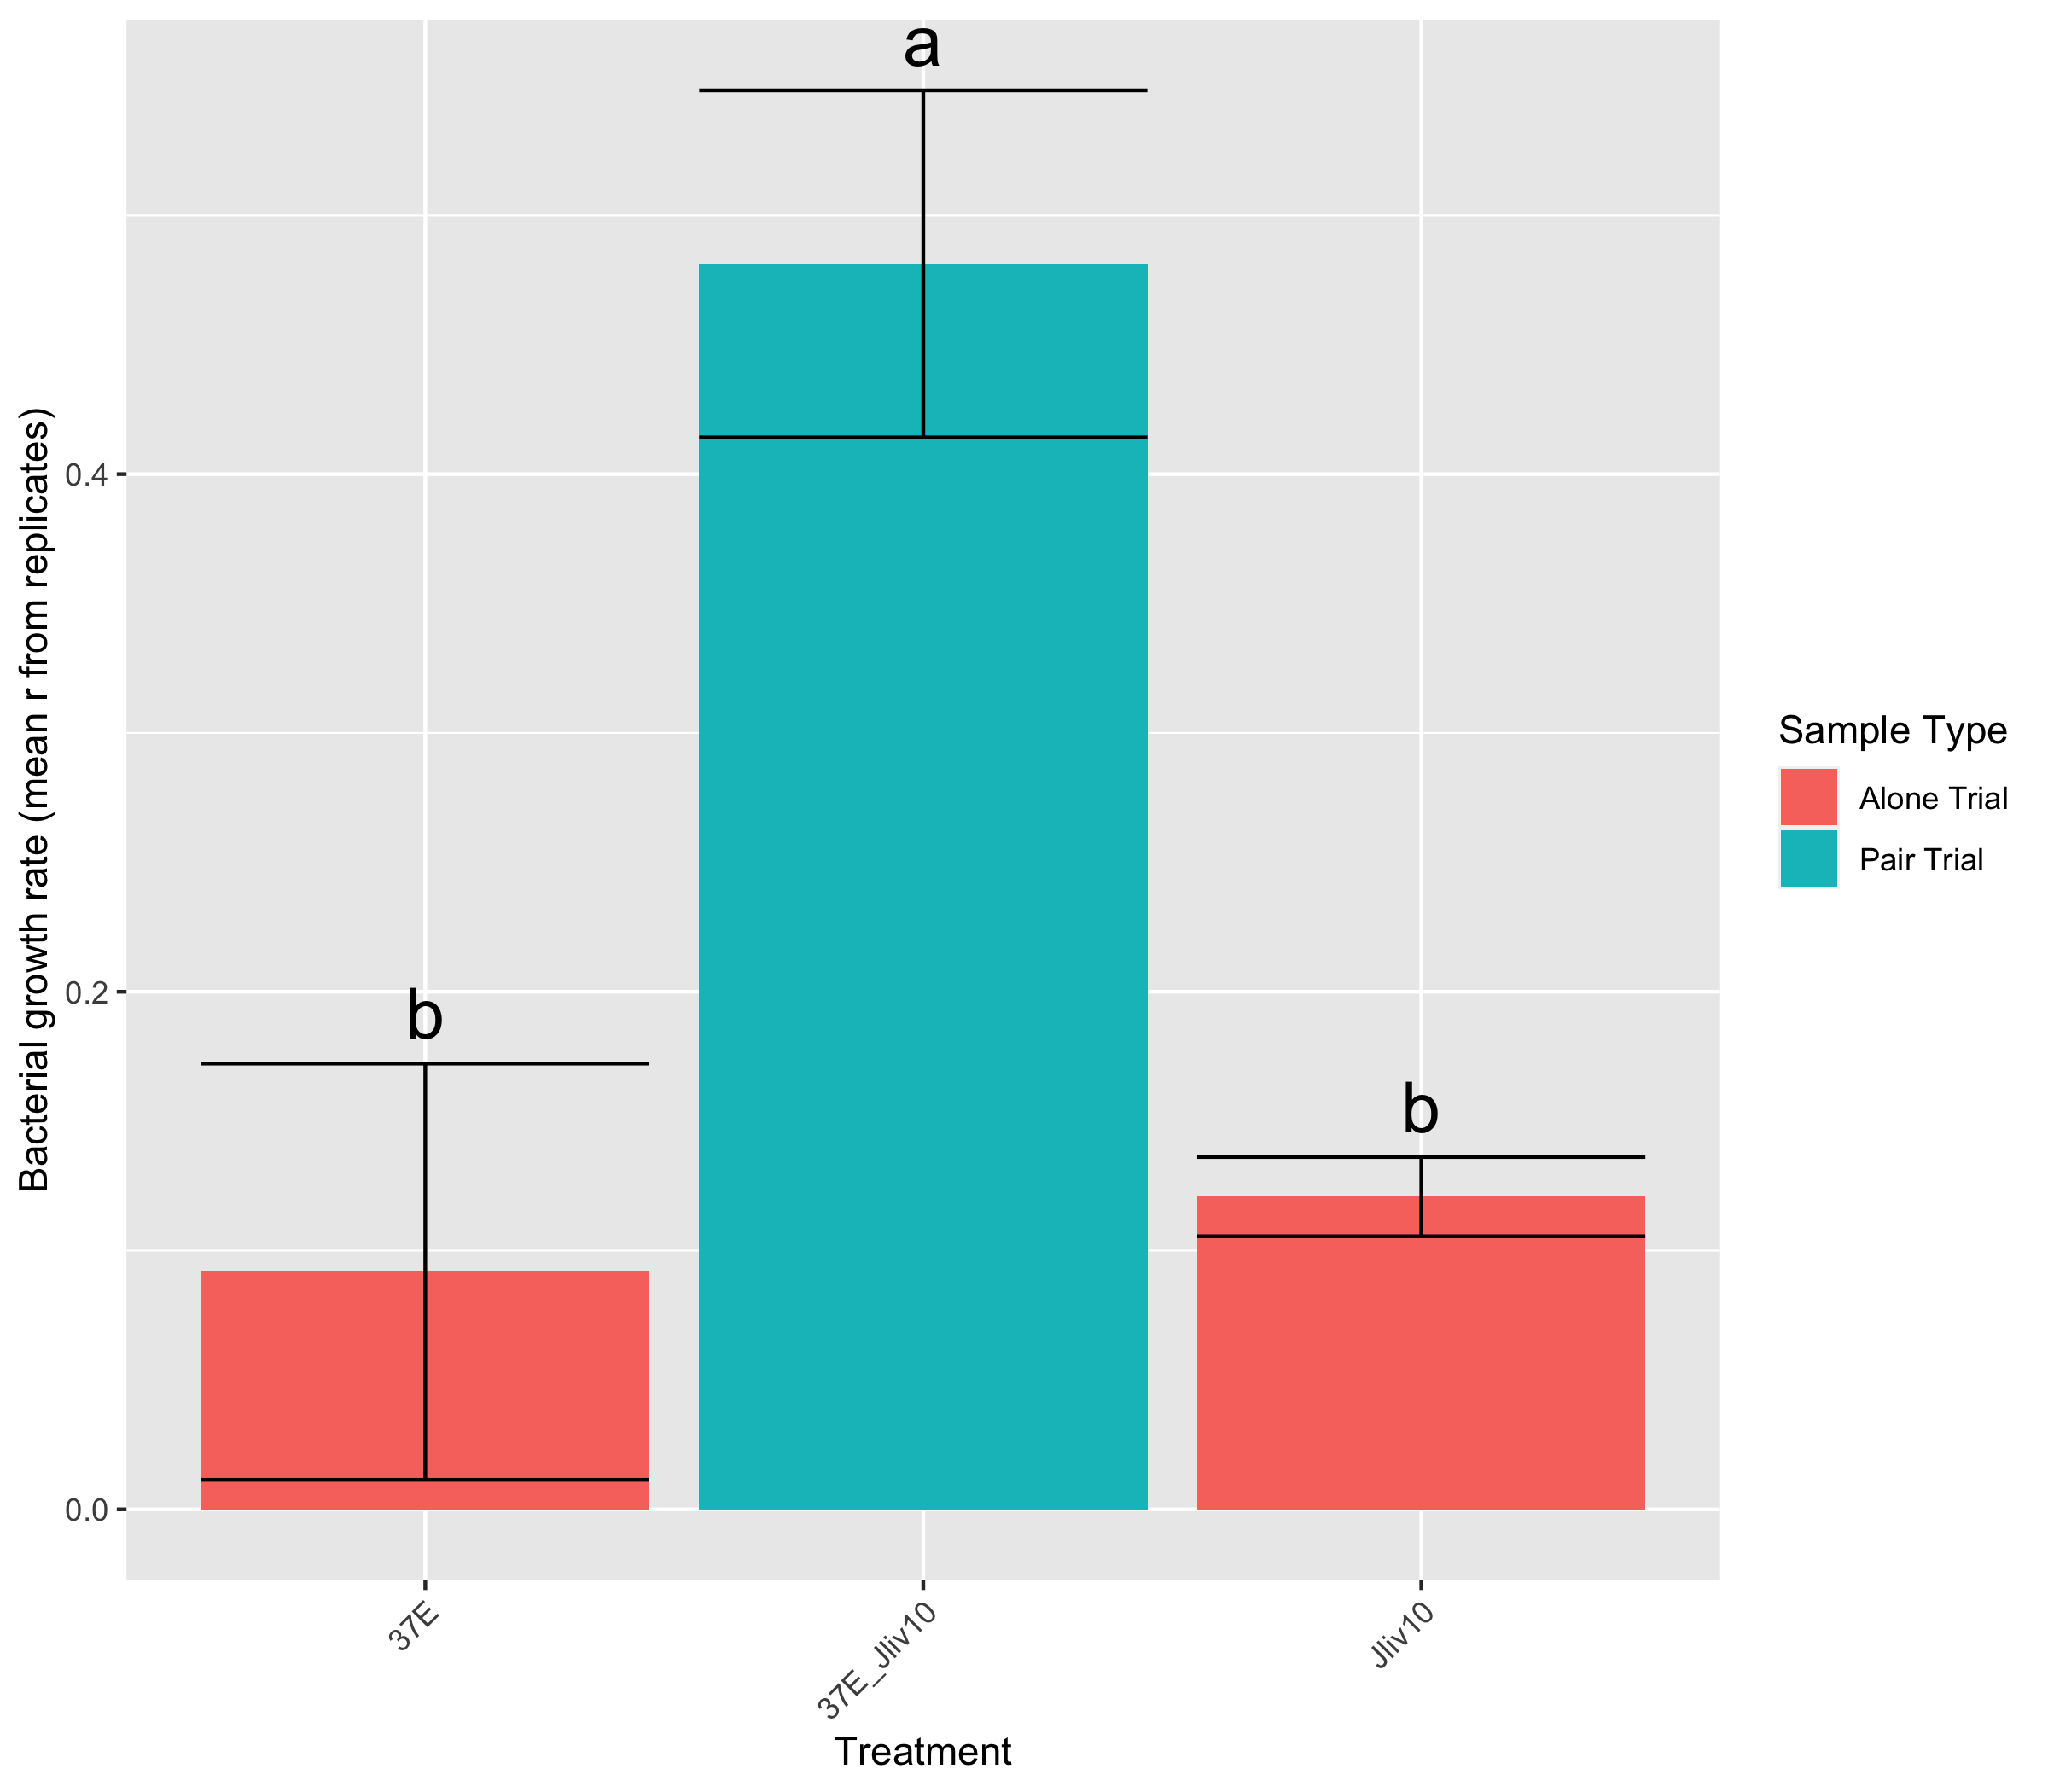
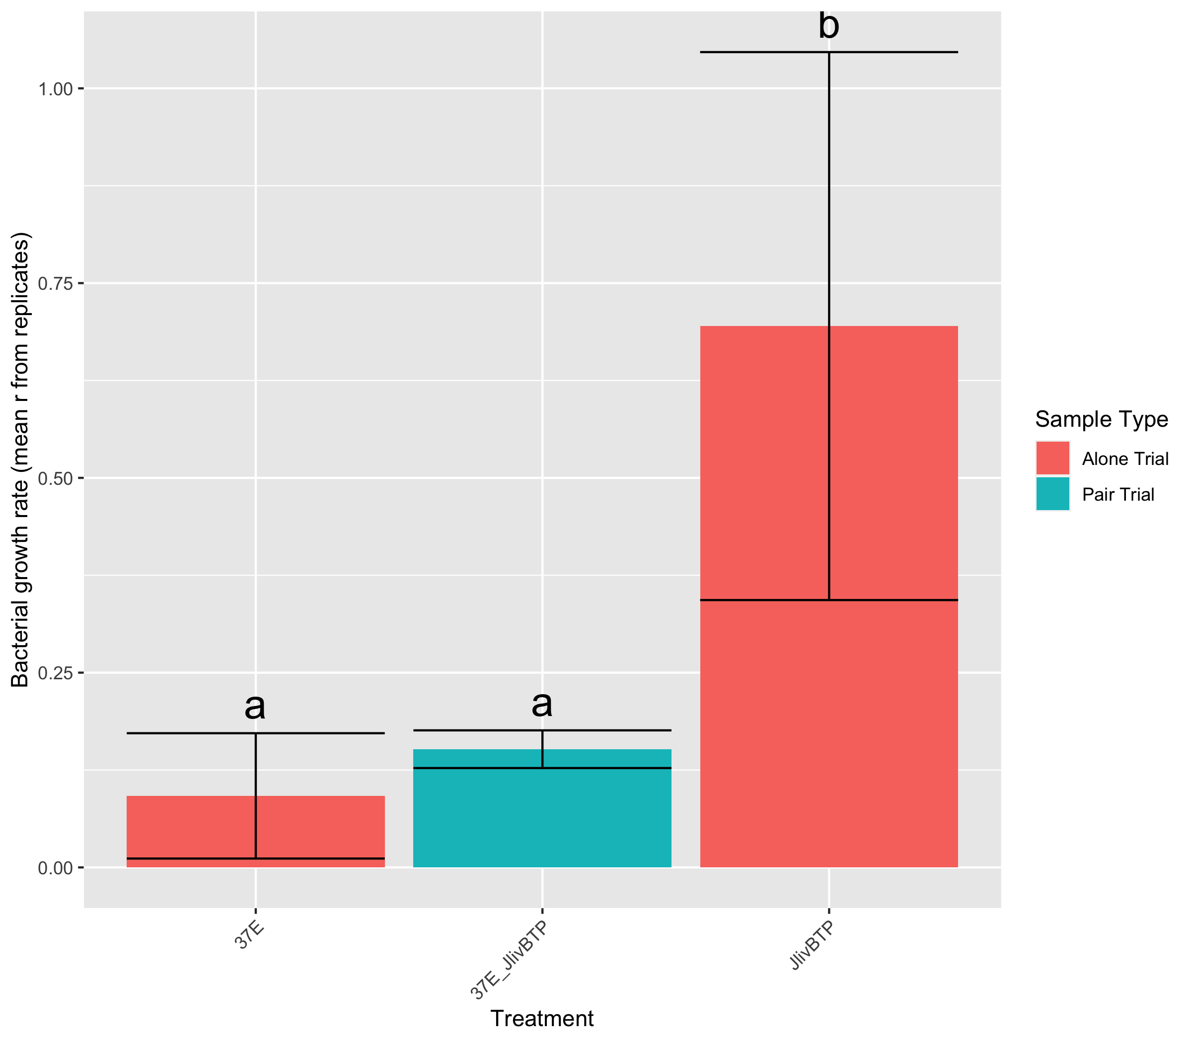
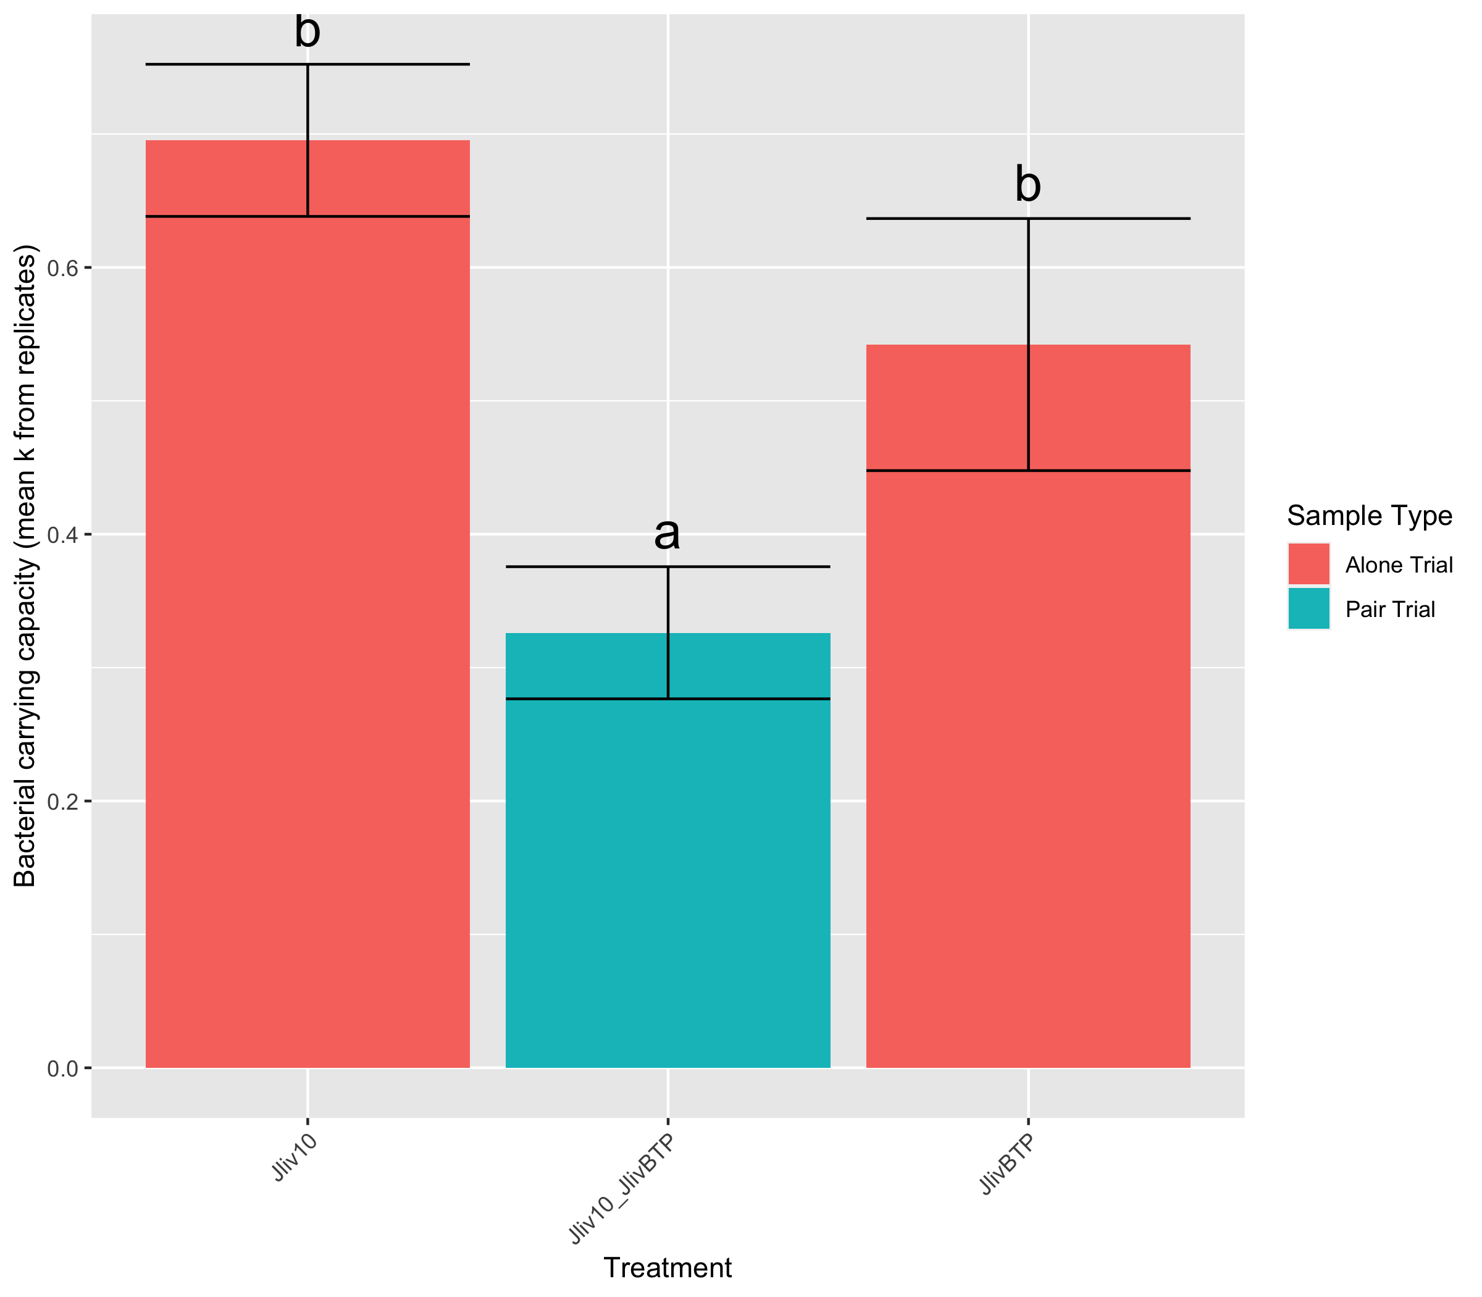
Increased growth rate together than alone
One microbe negatively effects other microbe’s growth rate
One microbe negatively effects other microbe’s carrying capacity
Chryseobacterium
Chryseobacterium and Pseudomonas
Pseudomonas
Burkholdariales
Burkholdariales and Jliv BTP
Jliv BTP
Burkholdariales
Burkholdariales and Jliv 10
Jliv 10
Microbacterium
Microbacterium and Jliv 10
Jliv10
Microbacterium
Microbacterium and Jliv BTP
Jliv BTP
Jliv 10
Jliv 10 and Jliv BTP
Jliv BTP

Slide 13
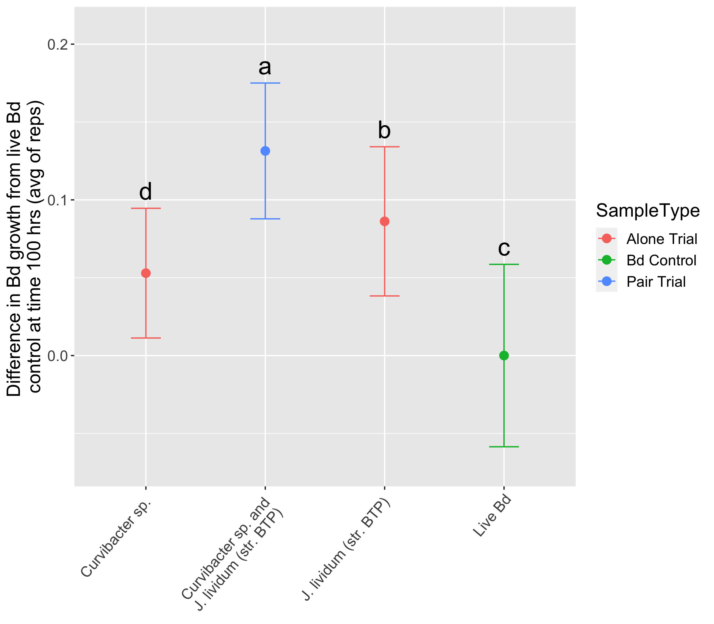
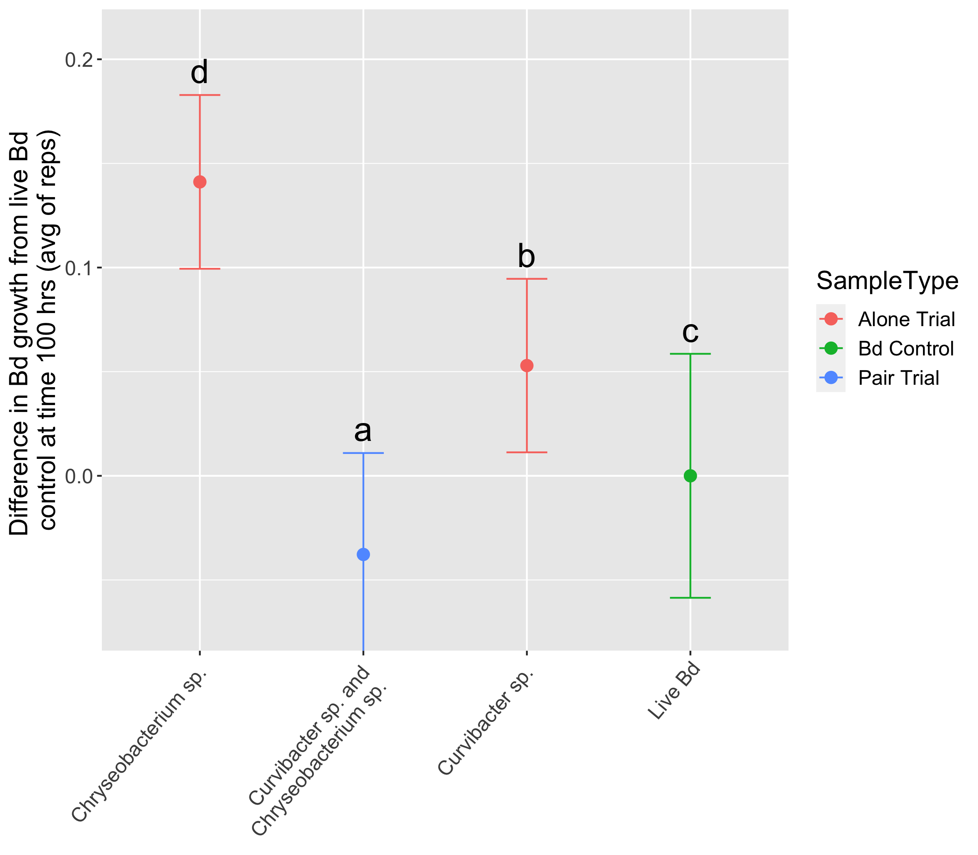
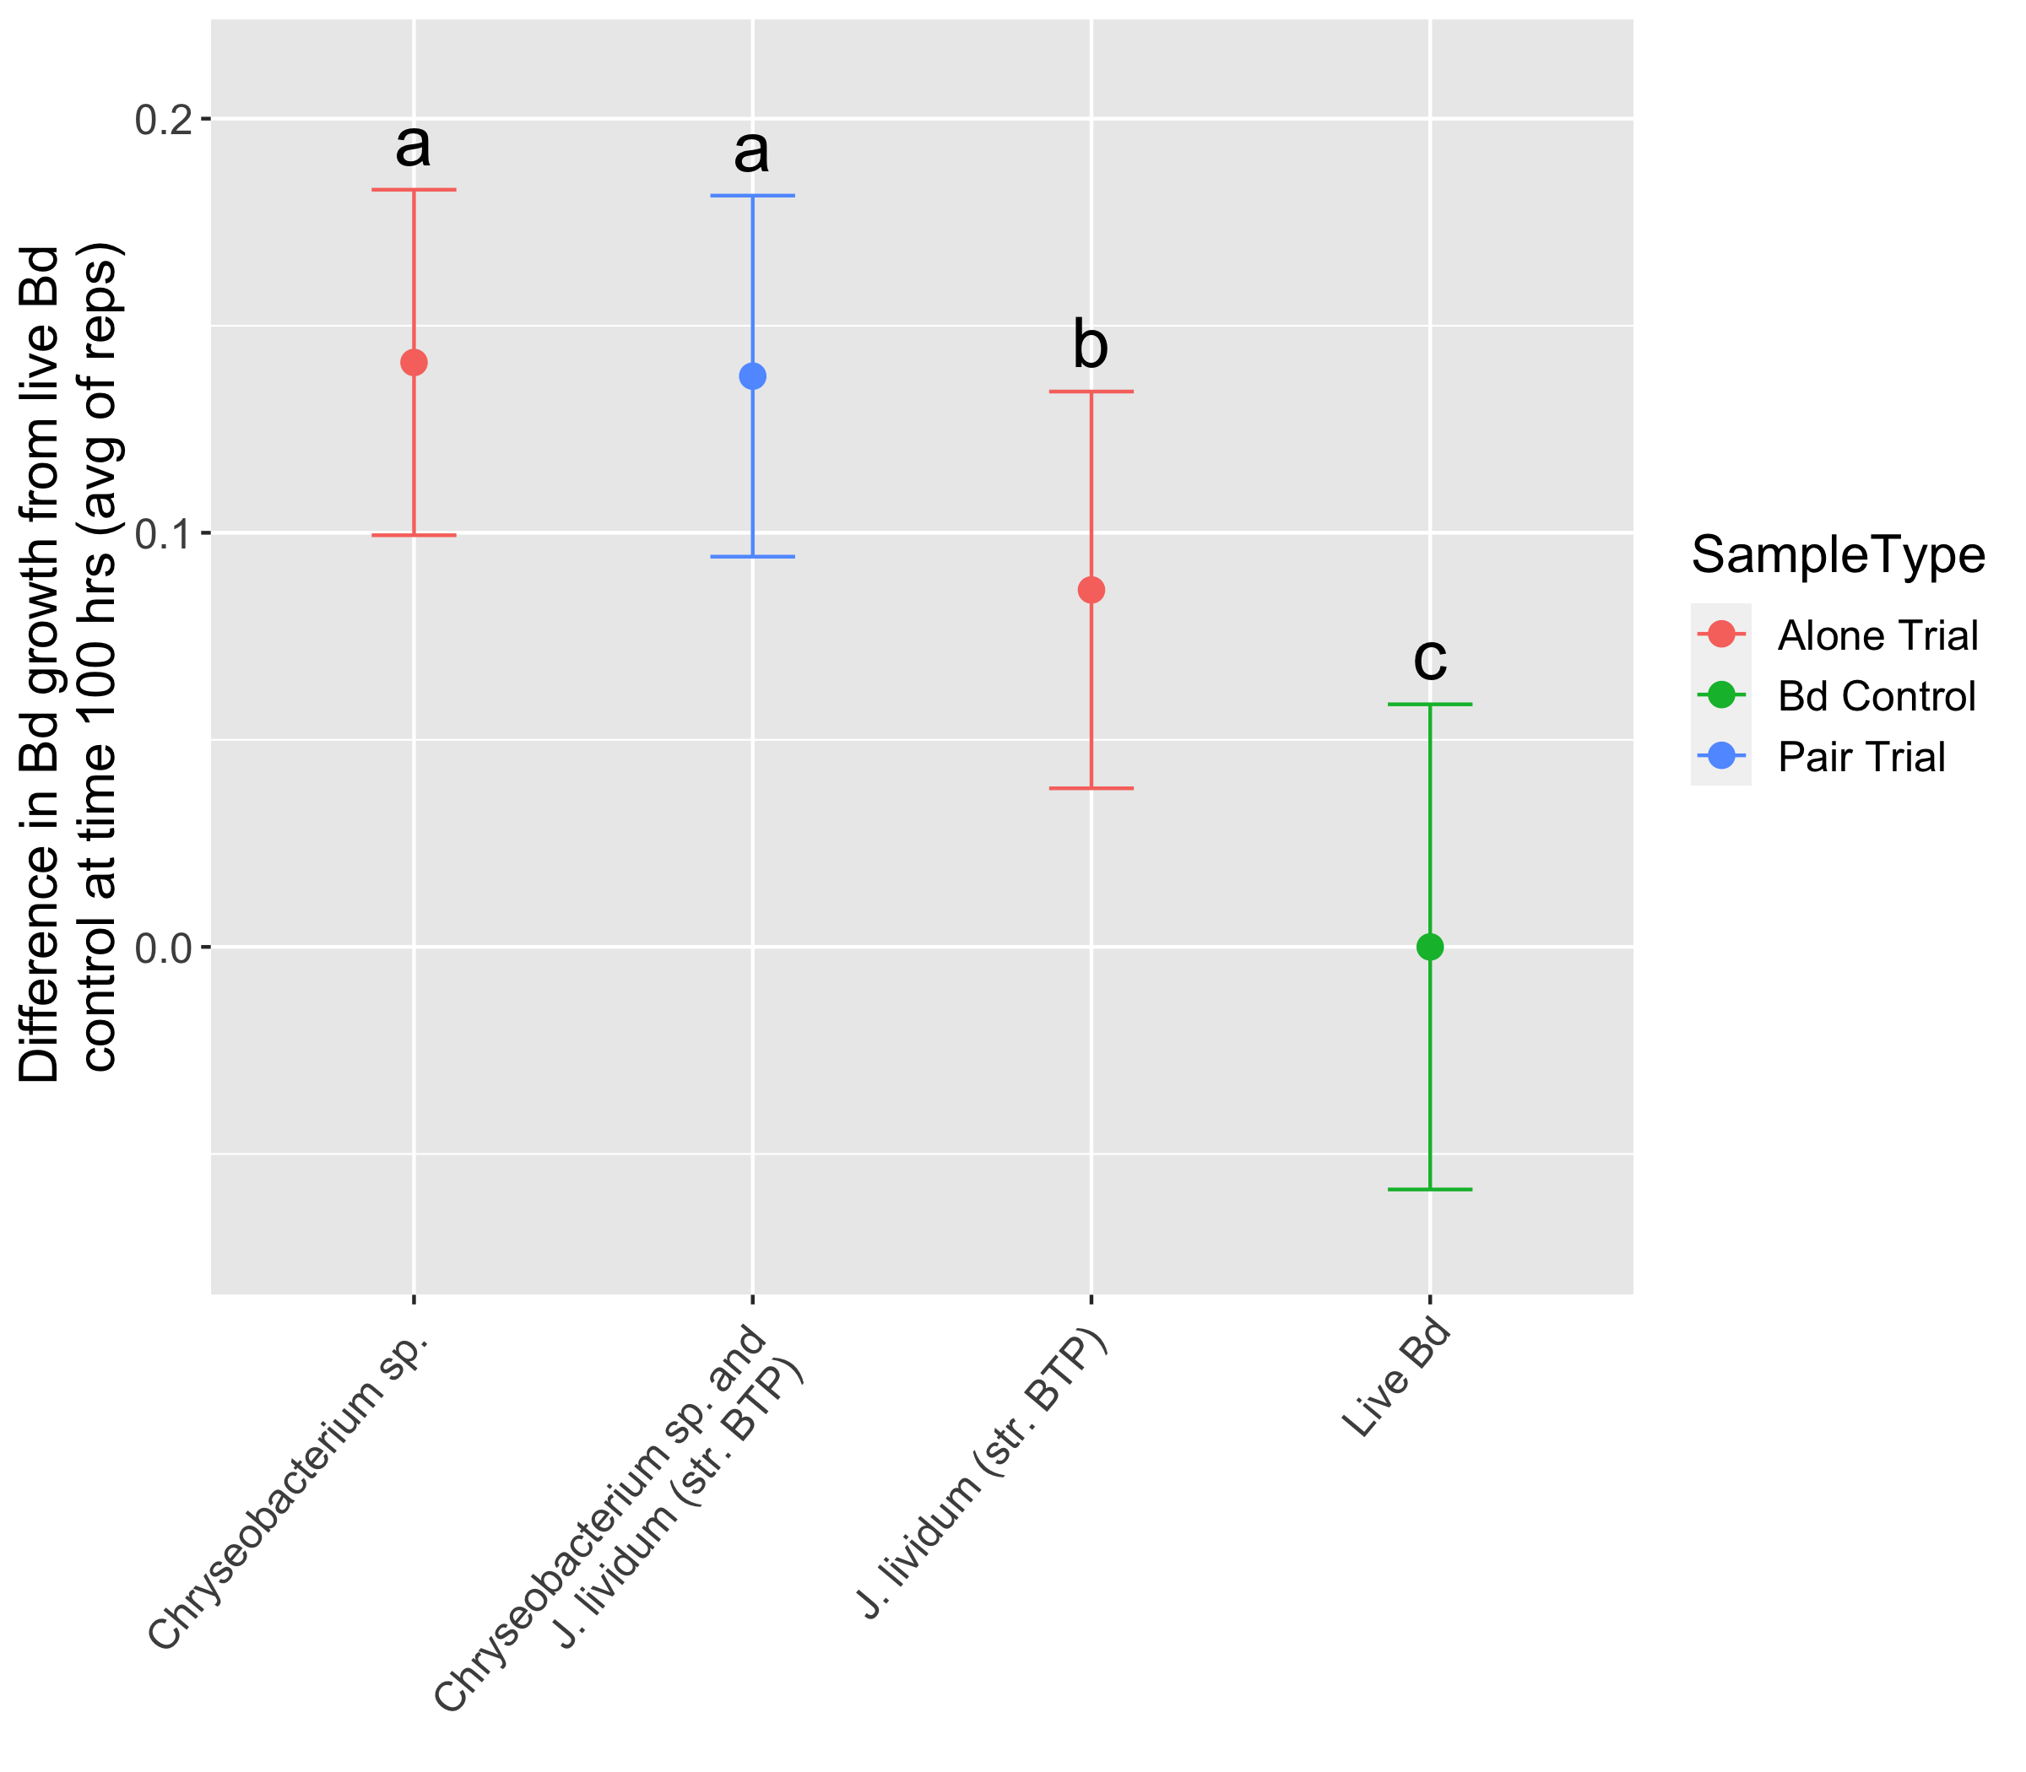
A
Additive
B
Antagonistic
C
Antagonistic

Slide 14
Antagonistic
Antagonistic
Antagonistic
Antagonistic
Antagonistic
Antagonistic
Antagonistic
Antagonistic
Antagonistic
Antagonistic
Additive
Antagonistic
Antagonistic
Antagonistic
Antagonistic

Slide 15
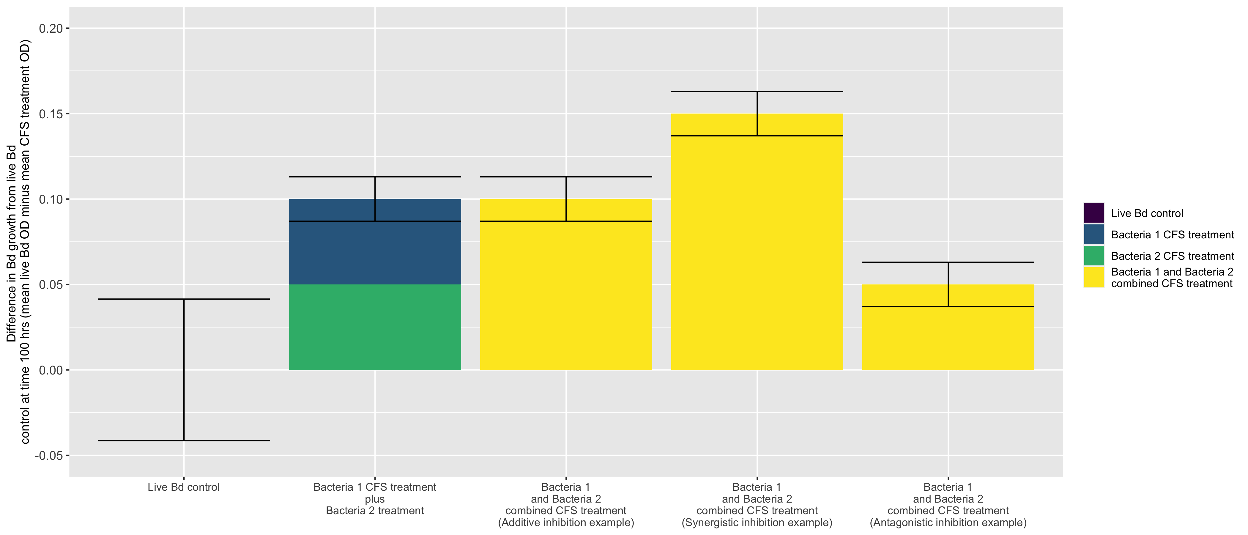
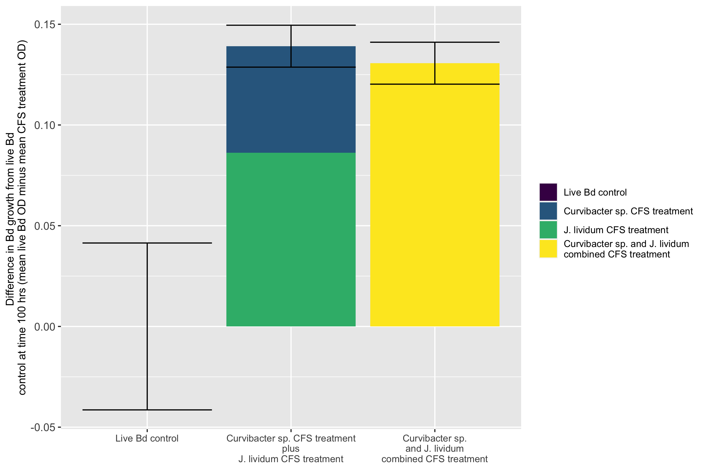
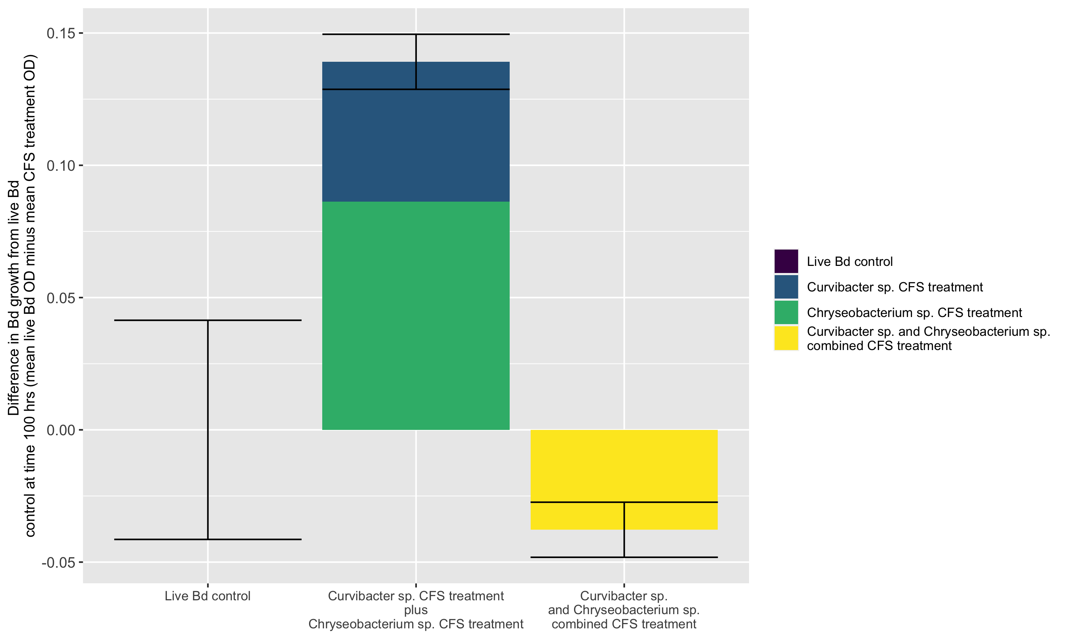
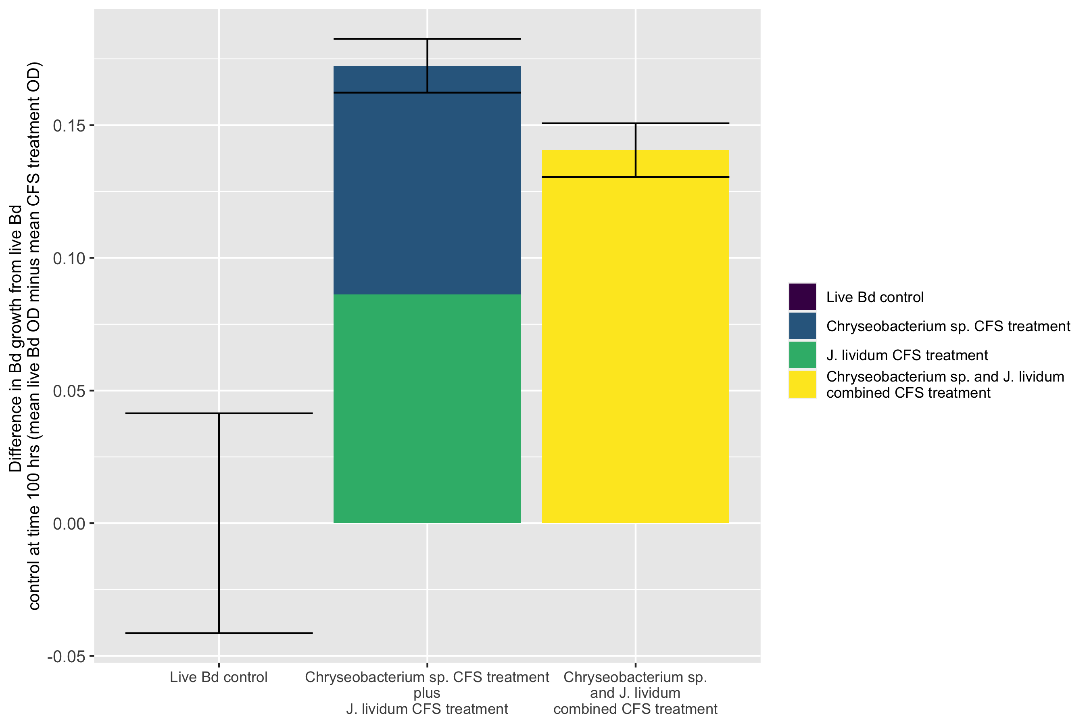
A
Significant, combined less than added
Significant, combined greater than added
n.s.
B
C
D

